Slide 1
Rezoning & Land Use Map Change 6224 SW 20th Avenue
Neighborhood Workshop May 11, 2020

Slide 2
Agenda
Introductions
Property Location
Property Description
Existing Zoning & Land Use
Proposed Zoning & Land Use Changes
Next Steps
Contact Information
Questions

Slide 3
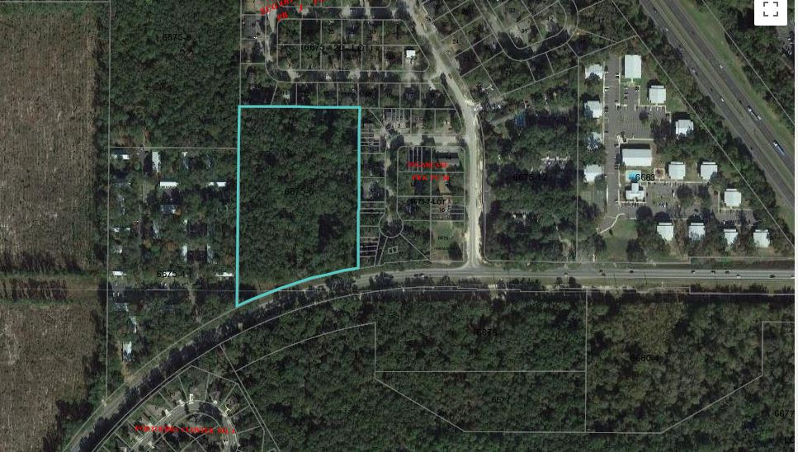
Site Location: 6224 SW 20th Avenue
Sugarfoot Oaks
SW 61st ST
Woodland Villas Apts.
I-75
Subject Property
Majestic Oaks Apts.
Sugarlane
SW 20th Ave
Treebecka Park Apts.
Portofino
Split Rock Conservation Area

Slide 4
Property Description
Property Size: 8.33 acres
Current Use: Vacant
Annexed into Gainesville in 2017
West of I-75 on the north side of SW 20th Avenue
Tax Parcel Number: 06675-006-000
Current zoning (RMF-5) allows multi-family residential as would the proposed zoning

Slide 5
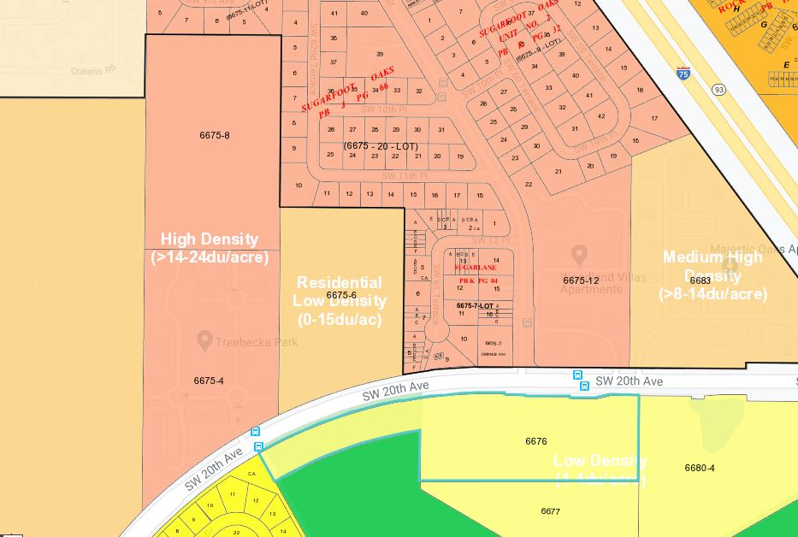
Existing Future Land Use Map
High Density (>14-24 du/acre)
Residential Medium (8-30 units/acre)
Single Family (up to 8 units/acre)

Slide 6
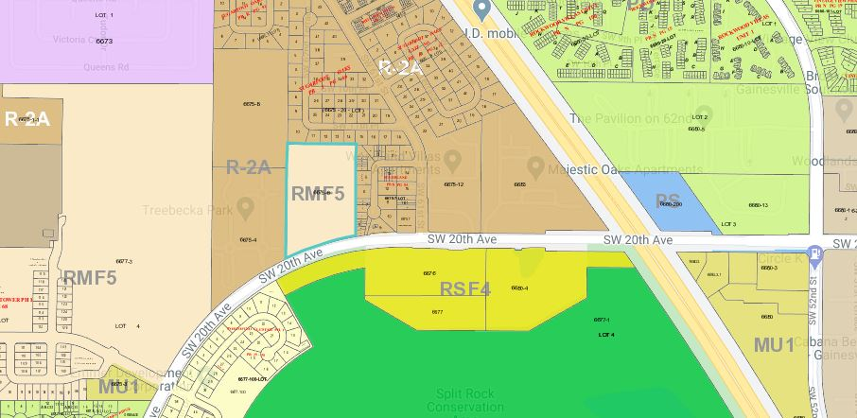
Existing Zoning Map
RM
RMF8
PD
RMF8
RMF7
RMF5
RSF1
CON

Slide 7
Proposed Changes
1. Change Future Land Use Map from Residential Low to Residential Medium
Density increase from up to 15 units per acre to 8 – 30 units per acre
2. Change Zoning Map from RMF-5 to RMF-8
Maximum density increase from 12 units per acre to 20 units per acre

Slide 8
Proposed Future Land Use Map
High Density (>14-24 du/acre)
Residential Medium
(8-30 units/acre)
Residential Medium
(8-30 units/acre)
Single Family (up to 8 units/acre)

Slide 9
Proposed Zoning Map
RM
RMF8
PD
RMF7
RMF8
RMF8
RMF5
RSF1
CON

Slide 10
Permitted Uses in RMF-8
Uses in the RMF-8 zoning district are generally the same as those allowed in the RMF-5 zoning district
Uses include:
Multi-family dwellings
Places of religious assembly
Schools
Libraries
Parks
Assisted Living facilities

Slide 11
USES | RMF-5 | RMF-6 to 8
Accessory dwelling units | A | A
Adult day care homes | P | P
Assisted living facilities | P | P
Attached dwellings (up to 6 attached units) | P | P
Bed and breakfast establishments | P | P
Community residential homes (up to 6 residents) | P | P
Community residential homes (7 to 14 residents) | - | P
Community residential homes (over 14 residents) | - | P
Day care centers | P | P
Dormitory, small | - | P
Dormitory, large | - | S
Emergency shelters | - | P
Family child care homes | P | P
Multi-family dwellings | P | P
Multi-family, small-scale (2-4 units per building) | P | P
Places of religious assembly | P | P
Libraries | S | S
Public parks | P | P
Schools (elementary, middle and high) | P | P
Single-family dwellings | P | P
Skilled nursing facility | - | S
Social service homes/halfway houses | - | S

Slide 12
Next Steps
eda will submit the applications for rezoning and land use change to the City of Gainesville
City of Gainesville will review the applications
City of Gainesville will notify neighboring property owners of the public hearing before the City Plan Board
Plan Board meeting (summer 2020?)
City Commission meeting (fall 2020?)

Slide 13
Contact Information
Person: Onelia Lazzari
Phone: (352) 373-3541
Web site: edafl.com
Email: olazzari@edafl.com
Mail: 720 SW 2nd Avenue
South Tower, Suite 300
Gainesville, FL 32601

Slide 14
Questions

