Slide 1
East University Ave Cottages.
Neighborhood Meeting
September 14, 2020

Slide 2
Summary
Parcel 11233-001-000 (Approximately 2.66 acres)
Future Land Use – Residential Low Density (0-15 units/acre)
Zoning – RMF 5 (Multifamily Residential)
18 residential cottages proposed (rental units, not for sale)
Related stormwater and utility improvements to serve the development

Slide 3
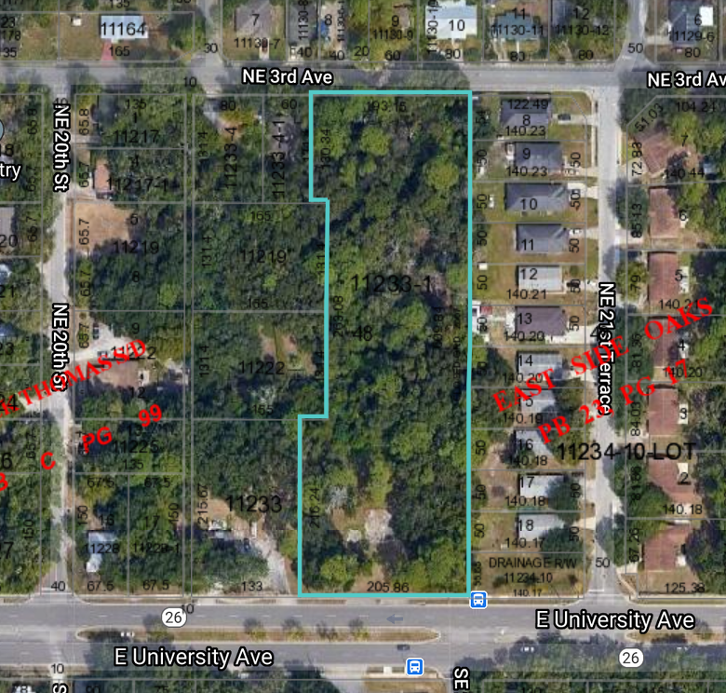
Site Aerial
2000 block of E University Avenue
Currently Undeveloped

Slide 4
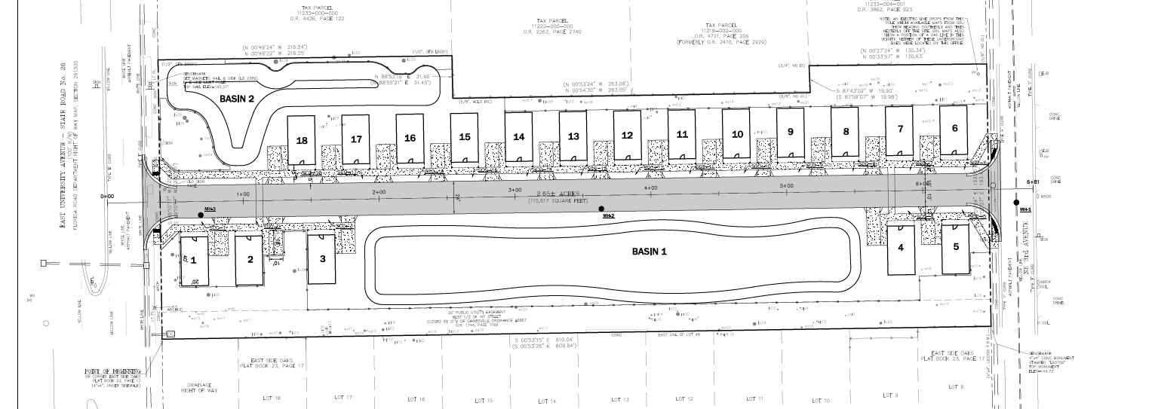
Proposed Site Plan

Slide 5
Next Steps
Neighborhood Workshop
Today – September 14, 2020
Site Plan Submittal and Review Process
October – December 2020
Project Approval and Construction
Early 2021

