Slide 1
Pressure Technology, Inc.
Neighborhood Meeting
July 28, 2020

Slide 2
Summary
Portion of Parcel 05949-011-006 (Parcel 05949-011-008)
Future Land Use – Industrial
Zoning – Industrial, Light and Warehousing (ILW)
Proposed 12,000(+/-) SF building with associated parking and utility improvements
Stormwater directed to master system for development

Slide 3
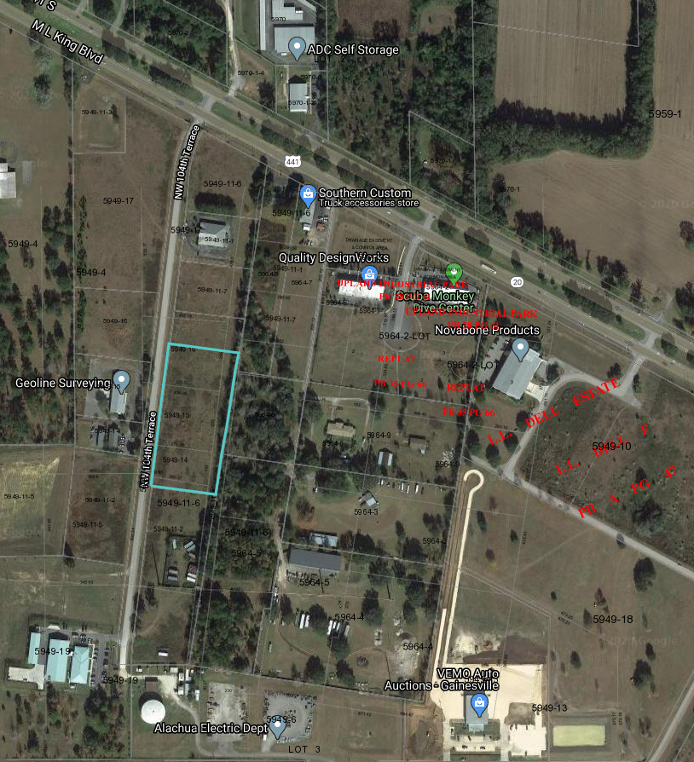
Location Map
13400 block of NW 104th Terrace

Slide 4
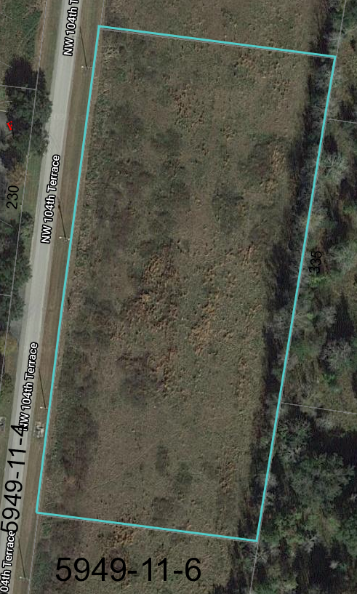
Site Aerial
Currently Undeveloped

Slide 5
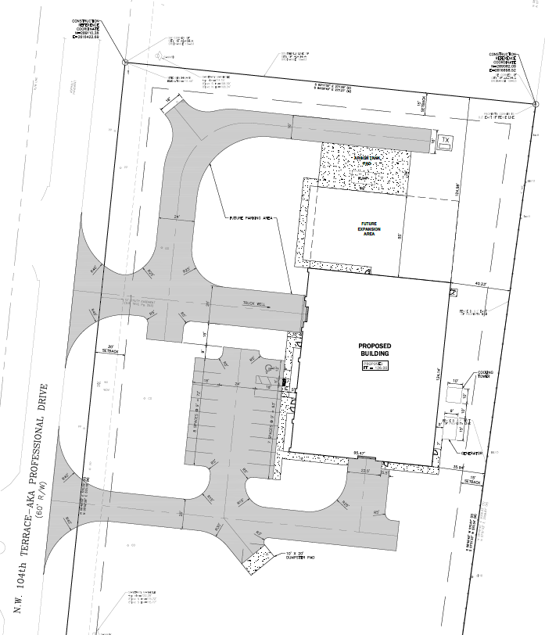
Proposed Site Plan

Slide 6
Next Steps
Neighborhood Workshop
Today – July 28, 2020
City of Alachua Site Plan Submittal for Staff Review
August 31, 2020
Planning and Zoning Board Approval
Expected November 10, 2020

