Slide 1
Sandvik – Testing Area
City of Alachua
Neighborhood Meeting
September 29, 2020

Slide 2
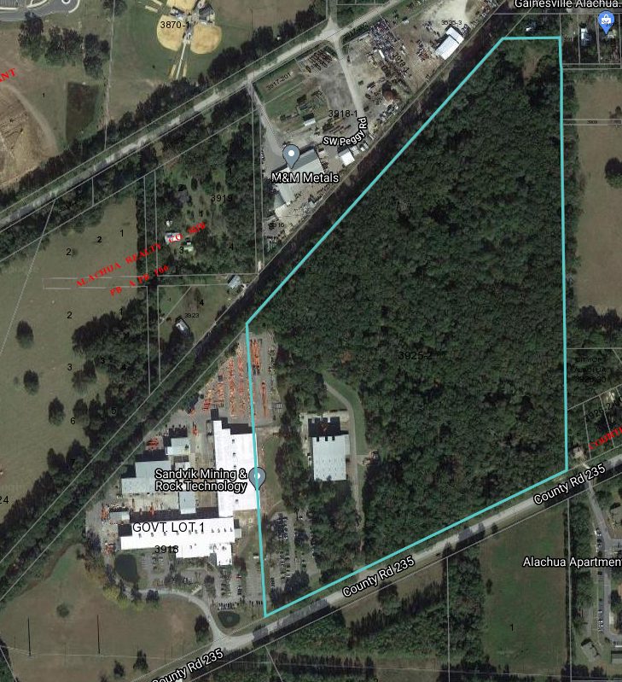
Site Aerial
Project Area

Slide 3
Summary
Proposed 250’ by 250’ (62,500 SF) stabilized area for testing of drill equipment on site with associated stormwater improvements.
13540 NW County Road 235
Portion of Parcel 03925-002-000
Future Land Use – Industrial
Zoning – Industrial, General (IG)

Slide 4
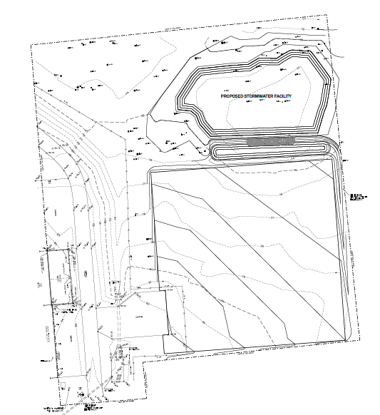
Site Plan
Stabilized area proposed east of existing buildings with stormwater system to the north.

Slide 5
Next Steps
Neighborhood Workshop
Today – September 29, 2020
Site Plan Submittal and Review Process
October – November 2020
Planning and Zoning Board Meeting
December 8, 2020
Presentation will be posted to: http://edafl.com/neighborhoodworkshops
Any Follow-up questions? Email sreyes@edafl.com or call 352-373-3541

