Slide 1
Rezoning, Land Use Map, & Text Changes 17129 April Boulevard
Neighborhood Workshop July 29, 2020

Slide 2
Agenda
Introductions
Property Location
Property Description
Existing Zoning & Land Use
Proposed Zoning & Land Use Changes
Proposed Text Change
Next Steps
Contact Information
Questions

Slide 3
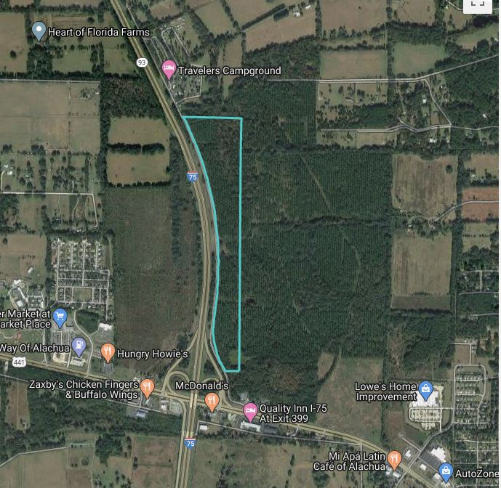
Site Location: 17129 April Boulevard
I-75
April Blvd
Proposed Rezoning & Land Use Change Areas
US 441

Slide 4
Property Description
Property Size: 58.26 +/- acres (18.6 +/- acres of the site proposed for change)
Current Use: Vacant/Silviculture
East of I-75 on the north side of US 441
Tax Parcel Number: 03020-000-000
Current land use categories: Recreation & Conservation
Current zoning Agricultural (A) & Conservation (CSV)

Slide 5
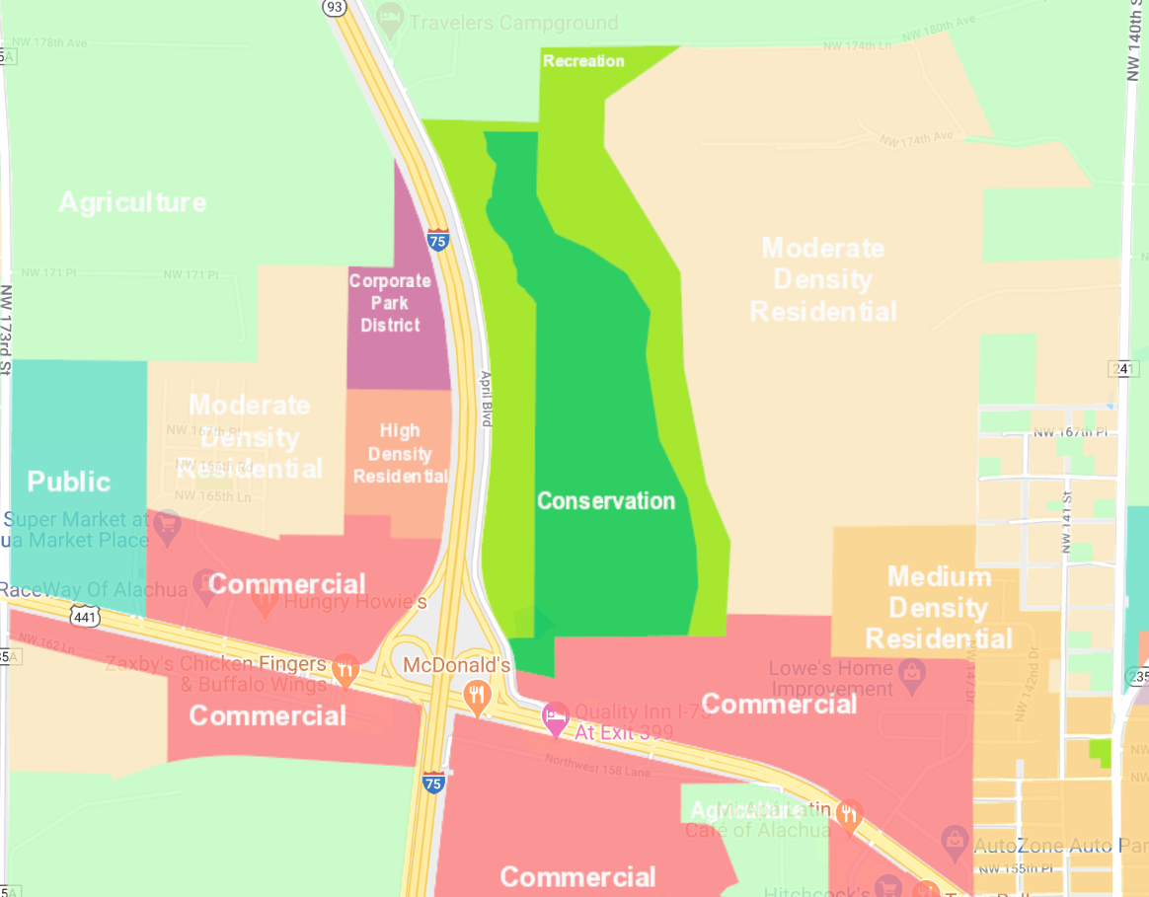
Land Use Map (Existing)
Recreation

Slide 6
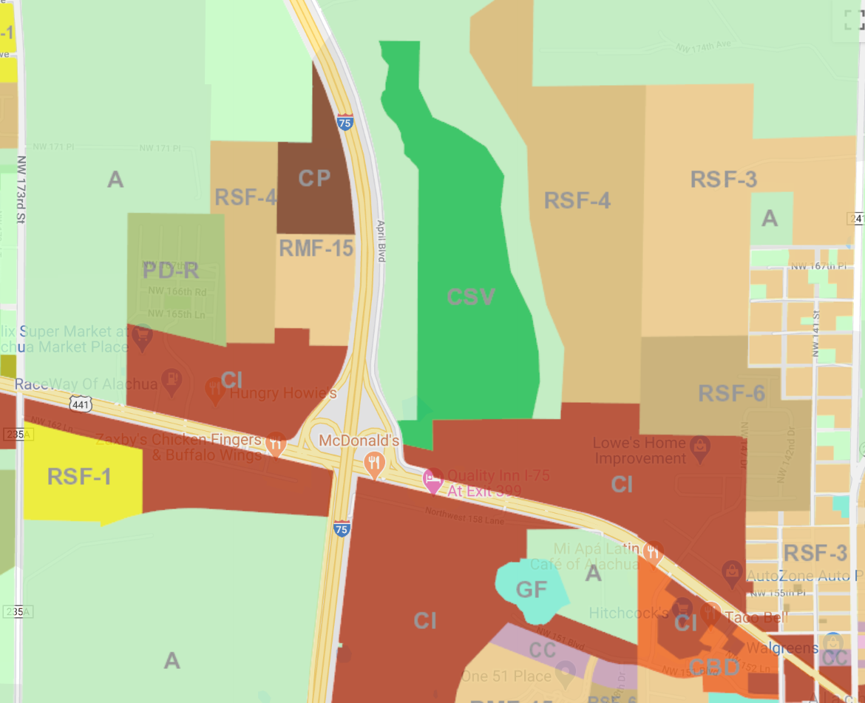
Zoning Map (Existing)
A

Slide 7
Proposed Changes
1. Change Future Land Use Map from Recreation to Conservation (8.1 acres) & Commercial (10.5 acres) for a portion of the site
2. Change Zoning Map from Agricultural to Conservation (8.1 acres) & Community Commercial (10.5 acres) for a portion of the site

Slide 8
Land Use Map (Proposed)
Recreation
Commercial
Conservation

Slide 9
Zoning Map (Proposed)
CSV
A
CC
CSV

Slide 10
Conservation future land use category and Zoning district
8.1 acres being added to Conservation land use & zoning to better protect newly identified wetlands on the site
Limited uses allowed in Conservation zoning including:
Public & private parks
Recreational trails
Non-intensive resource-based recreation uses

Slide 11
Commercial land use category & Community Commercial Zoning District 10.5 acres
Typical Uses:
Restaurant
Financial & professional services
Retail sales
Hotels & motels
Personal services
Offices (government, medical, & professional)
Typical Uses:
Multi-family dwellings
Dormitory
Library
Senior Center
Day Care Center
Schools
Nursing Home
Convention & Conference Centers

Slide 12
Proposed New Future Land Use Element Policy
Proposed to improve an existing problem caused by FDOT stormwater runoff from I-75
Proposed policy requires the applicant to provide feasible stormwater runoff water quality improvements for a portion of the runoff caused by I-75
The proposed stormwater runoff water quality improvements will be designed to encourage passive recreation like nature trails or pathways

Slide 13
Next Steps
eda will submit the applications for rezoning, land use, & text changes to the City of Alachua
City of Alachua will review the applications
City of Alachua will notify neighboring property owners of the public hearing before the Planning & Zoning Board
Planning & Zoning Board meeting (September or October 2020)
City Commission meeting (fall 2020)

Slide 14
Contact Information
Person: Onelia Lazzari
Phone: (352) 373-3541
Web site: edafl.com
Email: olazzari@edafl.com
Mail: 720 SW 2nd Avenue
South Tower, Suite 300
Gainesville, FL 32601

Slide 15
Questions

