Slide 1
SE Hawthorne Road
Rezoning Application
Neighborhood Workshop
July 22, 2020

Slide 2
Proposed Rezoning
Tax Parcel Numbers 16146-000-000 & 16117-000-000
Approximately 13.18 acres – a portion of the former Hillcrest Mobile Home Park.
Previous project proposed on the property as a Planned Development never occurred.
This rezoning application proposed a change from Planned Development (PD) zoning to:
R-2 (4-8 units per acre) for the southern 8.22 (+/-) acres
R-2A (8-14 units per acre) for the northern 4.96 (+/-) acres

Slide 3
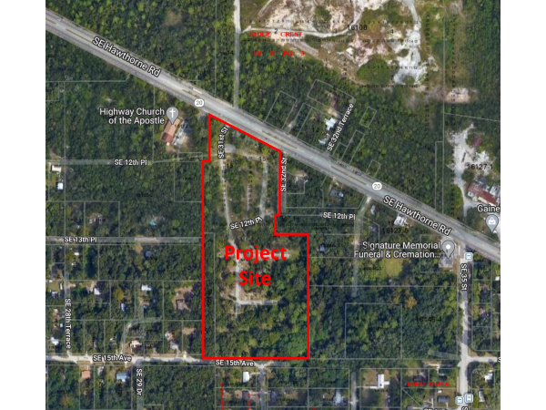
TITLE 1
TITLE 2
Paragraph Text
Bullet
Bullet
Bullet

Slide 4
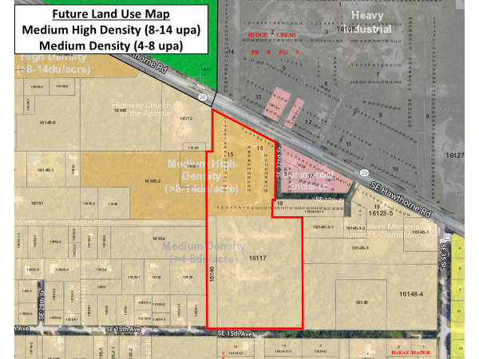
TITLE 1
TITLE 2
Paragraph Text
Bullet
Bullet
Bullet

Slide 5
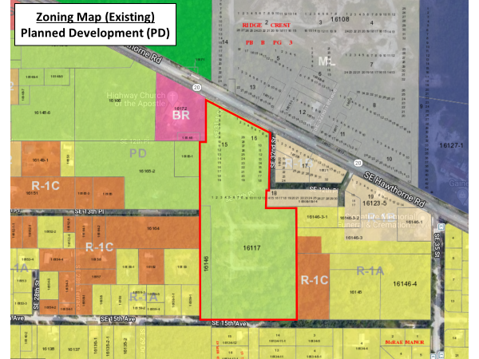
TITLE 1
TITLE 2
Paragraph Text
Bullet
Bullet
Bullet

Slide 6
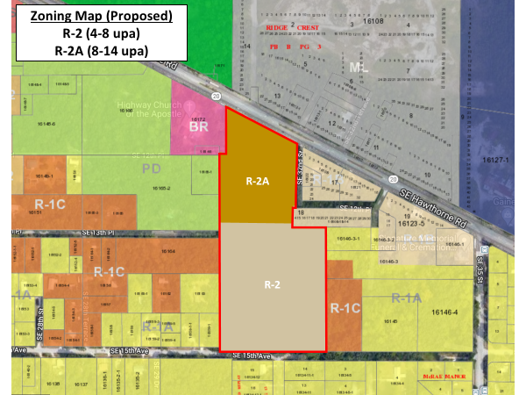
TITLE 1
TITLE 2
Paragraph Text
Bullet
Bullet
Bullet

Slide 7
Rezoning Process
Alachua County Growth Management
Neighborhood Workshop (Today)
Submit application for staff review
July 27, 2020
Planning Commission Meeting
September 2020
Alachua County Board of County Commissioners
Likely in October 2020

