Slide 1
Dance Alive
Rezoning & Small-Scale Land Use Map Amendment
Neighborhood Workshop January 30, 2023

Slide 2
Meeting Guidelines
This meeting is informational only
It is required as a part of the City review process
You have been muted upon entering
If you have a question, either:
Unmute yourself to speak
Type your question in the chat box
⬇ UNMUTE/MUTE ⬇ CHAT

Slide 3
Agenda
Introductions
Property Location & Description
Existing Zoning & Land Use Map
Proposed Zoning & Land Use Changes
Next Steps
Contact Information
Questions

Slide 4
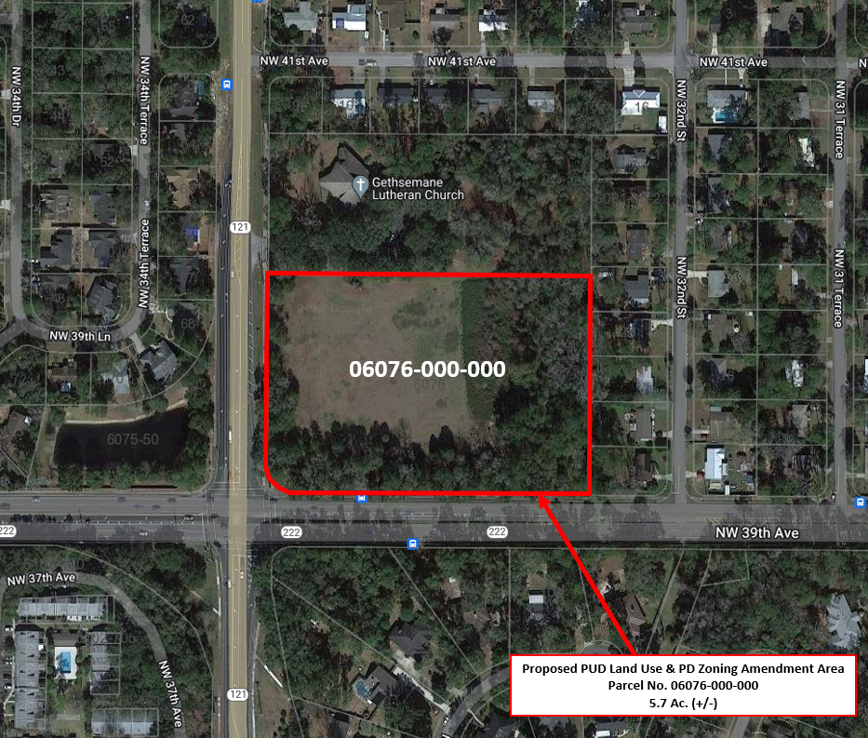
NW 34th St.
Property Location Map
NW 39th Ave.

Slide 5
Proposed Land Use & Zoning Changes
Land Use Map
From: Single Family 5.7 Ac. (+/-)
To: Planned Use District 5.7 Ac. (+/-)
Zoning Map
From: RSF-4 5.7 Ac. (+/-)
To: Planned Development (PD) 5.7 Ac. (+/-)
Summary of Proposed Changes
Change permitted uses of land from residential to a site-specific zoning that will allow Dance Alive to locate on the property.

Slide 6
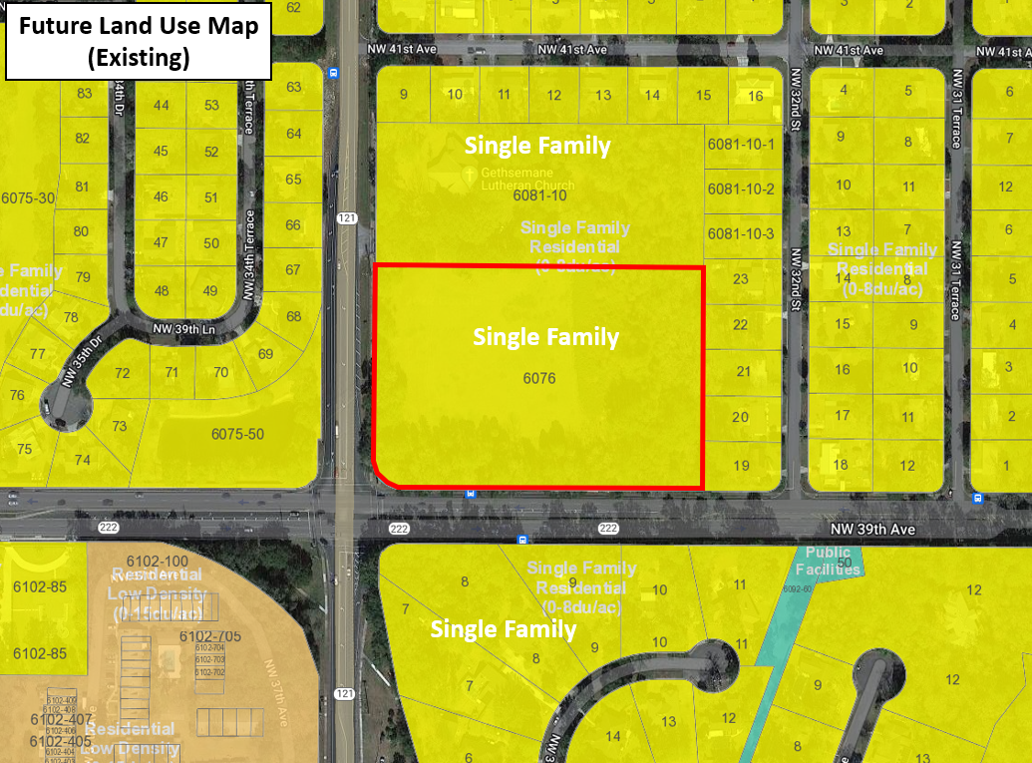
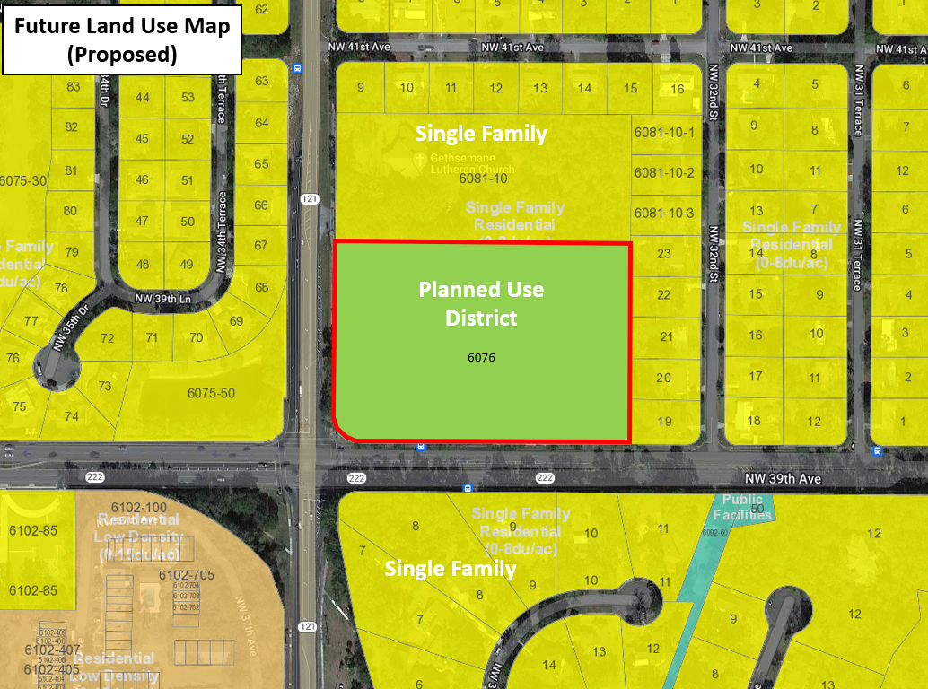
Proposed Land Use Map Change
NW 34th St.
NW 34th St.
NW 39th Ave.
NW 39th Ave.
Proposed Land Use Map Change:
From: Single Family (5.7 Ac. +/-)
To: Planned Use District (5.7 Ac. +/-)

Slide 7
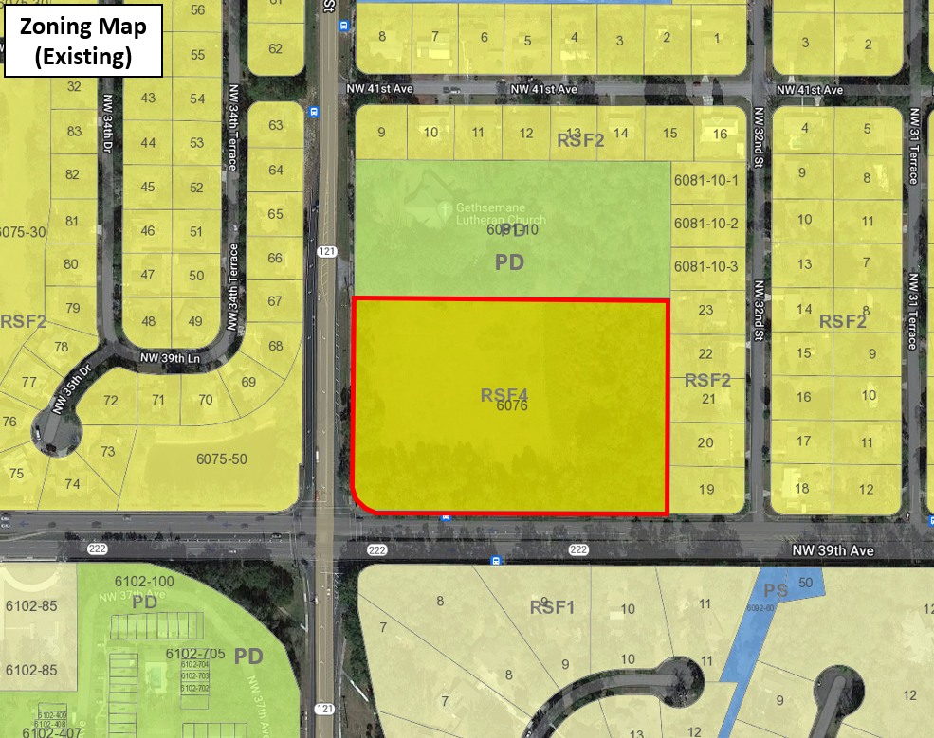
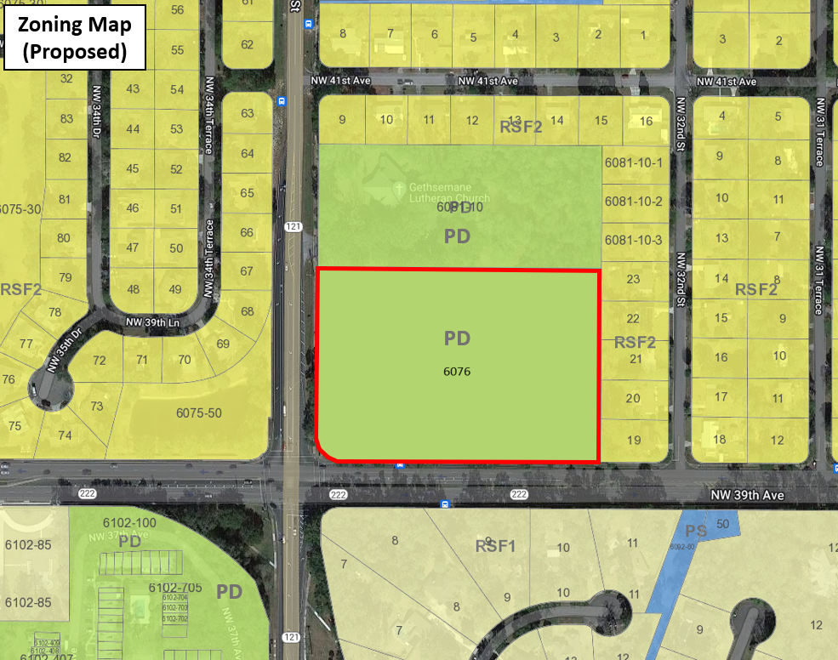
Proposed Zoning Map Change
NW 34th St.
NW 34th St.
NW 39th Ave.
NW 39th Ave.
Proposed Zoning Map Change:
From: RSF-4 (5.7 Ac. +/-)
To: Planned Development (5.7 Ac. +/-)

Slide 8
Land Use & Zoning Changes
Permitted Uses in PD / PUD
a. Dance studio including classes and rehearsals
b. Yoga and Pilates classes
c. Music classes
d. Theater for accessory dance and music performances
e. Customary accessory uses
f. Theater rental for non-profit cultural organization performances
g. Accessory outdoor events in central open space area
h. Storage building
Note: Proposed Land Use & Zoning Map will not allow other uses. Only the uses proposed will be permitted. This is not a rezoning to commercial, which could allow a wide variety of uses, like gas stations, convenience stores, etc.

Slide 9
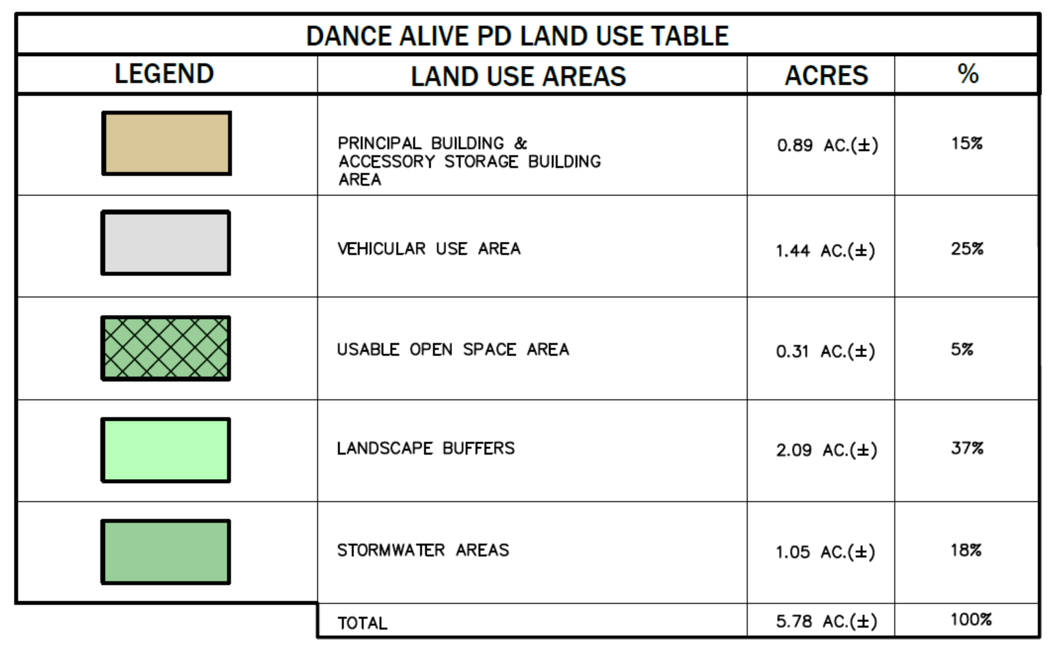
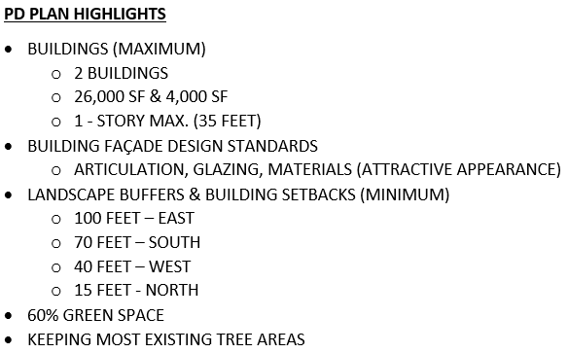
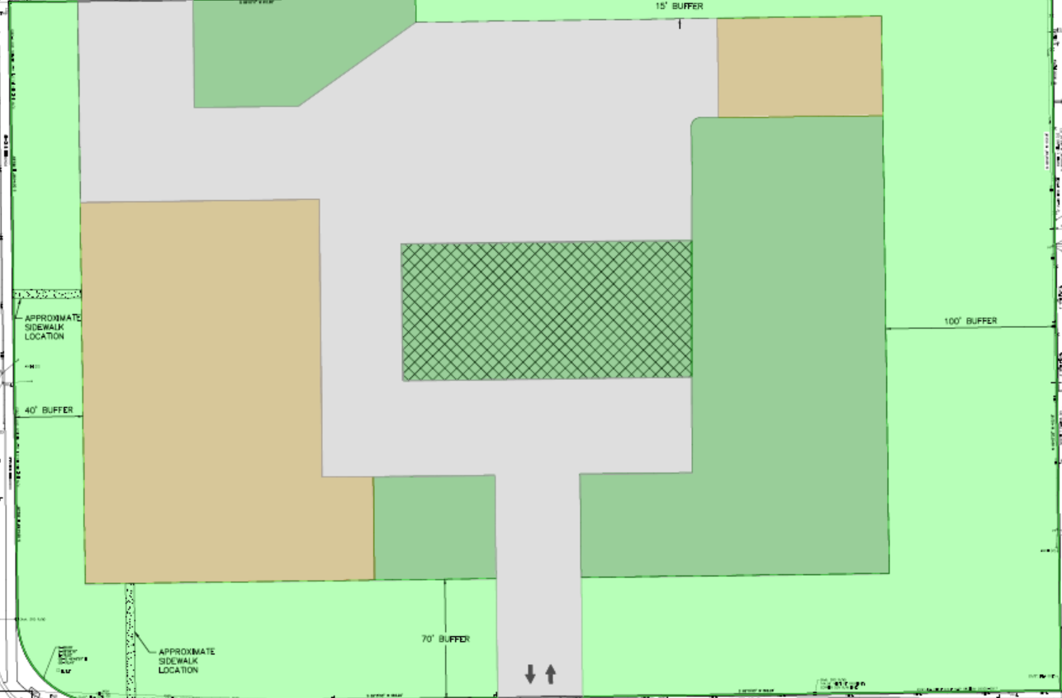
BLDG.
PD Plan
&
Aerial Photo
DRIVEWAY / PARKING
SMF
BUFFER
BUILDING
BUFFER
BUFFER
NW 39th Ave.
NW 34th St.

Slide 10
Next Steps
EDA will submit the applications for rezoning and land use change to the City of Gainesville
City of Gainesville will review the applications
City of Gainesville will notify neighboring property owners of the public hearing before the City Plan Board
Plan Board meeting (TBD: Approx. 3 Months)
City Commission meeting (TBD: Approx. 5 Months)
When Development Plan application is submitted, there will be an additional neighborhood meeting & notification process

Slide 11
Contact Information
Person: Clay Sweger
Phone: (352) 373-3541
Email: csweger@edafl.com
Web site: www.edafl.com/neighborhoodworkshops
Mail: 720 SW 2nd Avenue
South Tower, Suite 300
Gainesville, FL 32601

