Slide 1
Tara Esmeralda
Revised Preliminary Development Plan
Alachua County
Neighborhood Meeting
April 30, 2023

Slide 2
Meeting Guidelines
This meeting is informational only
You have been muted upon entering
If you have a question, either:
Unmute yourself to speak
Type your question in the chat box
⬇ UNMUTE/MUTE
⬇ CHAT

Slide 3
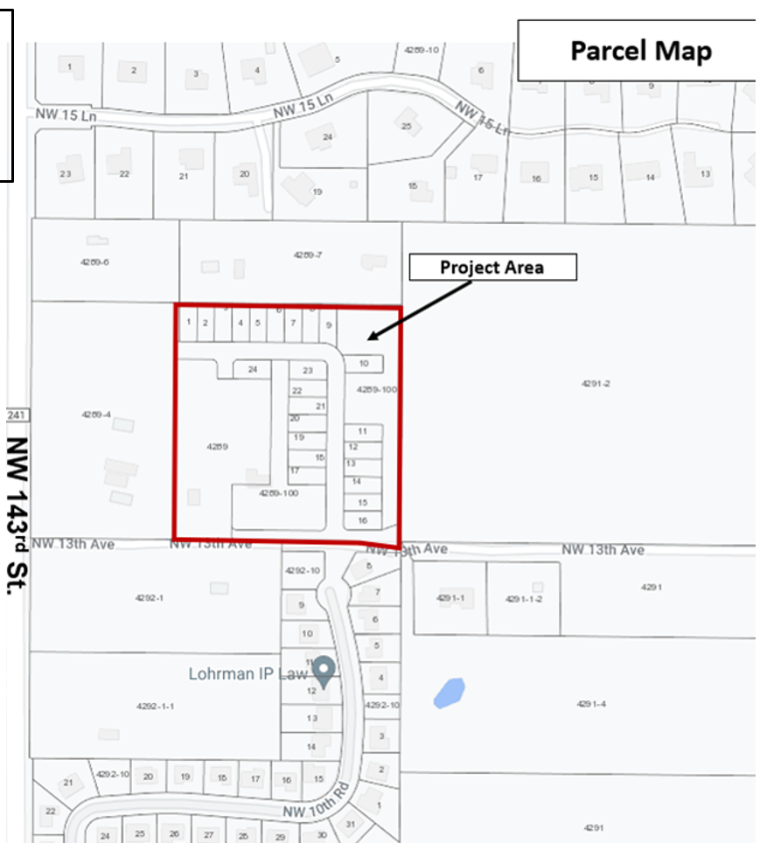
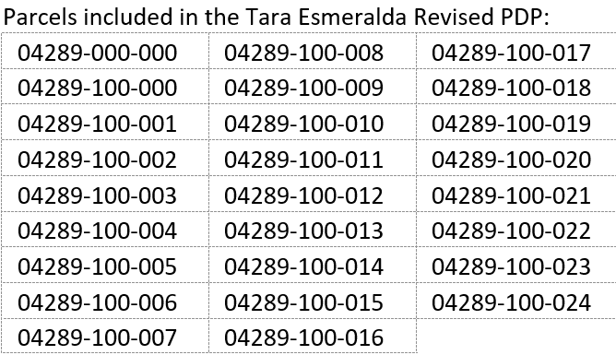
Parcel Information
North of Strawberry Fields Subdivision
South of Saddlebrook Farms
West of Proposed Alachua Verde Subdivision
Zoning: R-1A
Future Land Use: Low Density (1-4 dwelling units per acre)
Tax Parcel Numbers:
Alachua Verde Subdivision

Slide 4
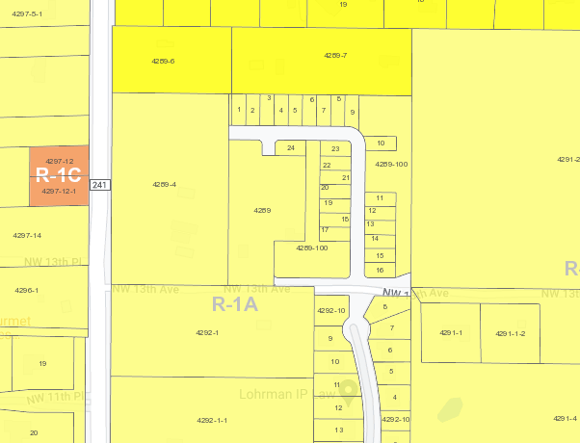
Property Zoning
Property is zoned R-1a and allows:
1-4 units per acre
Single family residential development
35-foot building height (max.)
Proposed project complies with the zoning regulations
R-1a
Proposed 16 Lots

Slide 5
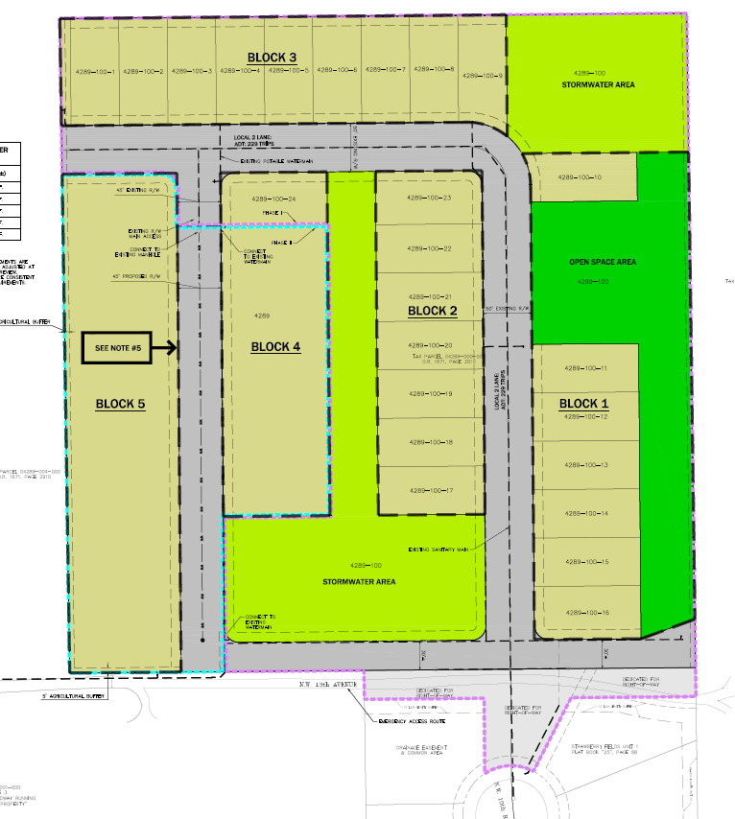
Revised Preliminary Development Plan
Proposed Single Family Detached Development includes 40 residential lots
24 lots in Phase 1 (Constructed)
16 lots in Phase 2 (Proposed)
Development includes:
Open Space and Tree Preservation Area
Landscaped Stormwater Facilities & Common Area
Request:
Renew Preliminary Development Plan (PDP) Approval
Clarify Condition Language RE: Road Connection to Alachua Verde
Phase 1
Phase 2

Slide 6
Next Steps
Neighborhood Workshop
Preliminary Development Plan Review Process
Final Development Plan Review Process
Presentation will be posted to: http://edafl.com/neighborhoodworkshops
Any Follow-up questions? Email sreyes@edafl.com or call 352-373-3541

