Slide 1
Oak Gate Condos – Phase 3
Neighborhood Meeting
May 22, 2023

Slide 2
Meeting Guidelines
This meeting is informational only
It is required as a part of the Alachua County review process
You have been muted upon entering
If you have a question, either:
Unmute yourself to speak
Type your question in the chat box
⬇ UNMUTE/MUTE ⬇ CHAT

Slide 3
Property Summary
Tax Parcel Numbers 08303-000-000 and 08306-010-003
Location: 2900 block of NW 8th Terrace
Future Land Use Map Designation: Residential Low Density
Zoning District: Multi-family Residential, RMF-5
Proposed change to add one building with an additional 24 residential units to the existing multifamily development with associated utilities, parking, and stormwater.

Slide 4
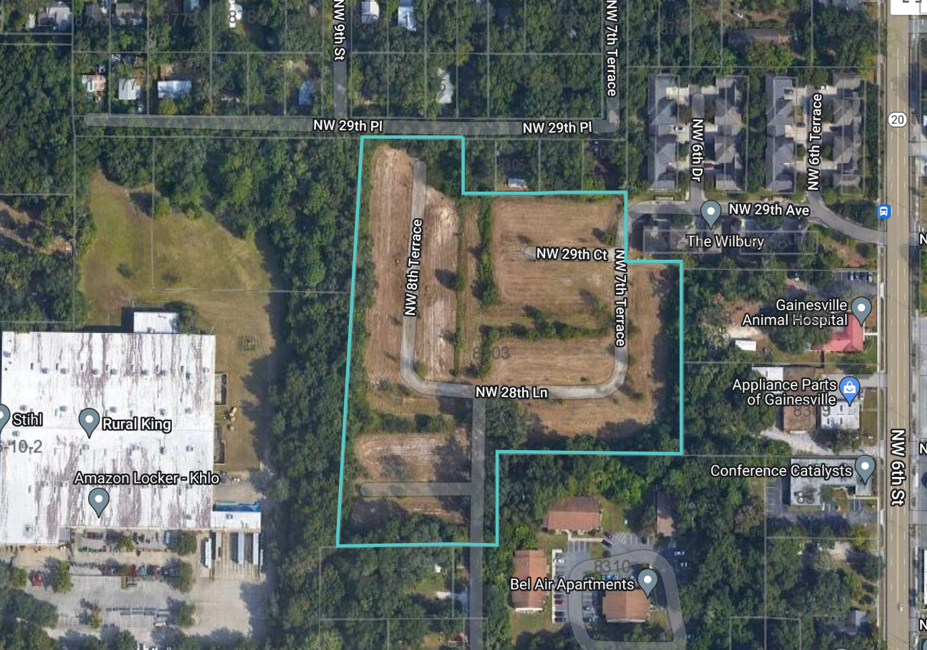
Location Map/Aerial

Slide 5
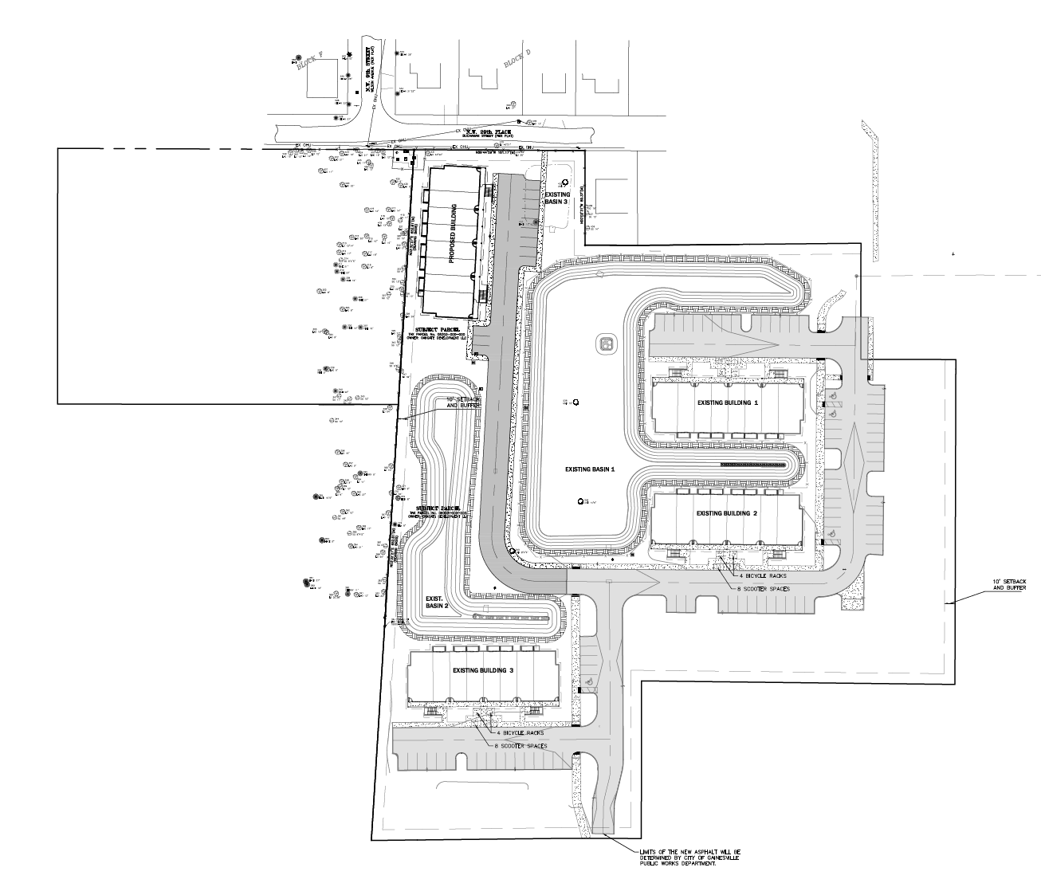
Proposed Site Plan –
No proposed improvements on Parcel 08306-010-003
(Previously part of Rural King Property)

Slide 6
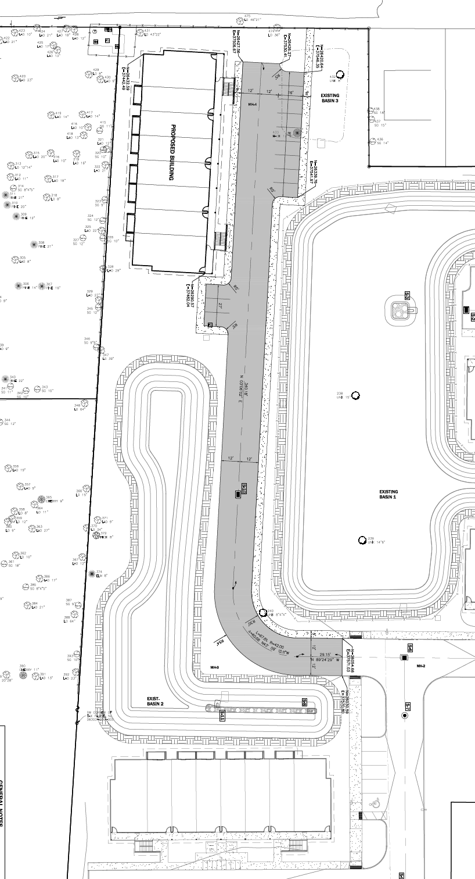
Proposed Site Plan –
One additional building with 24 residential units to the existing multifamily development with associated utilities, parking, and stormwater.
No proposed improvements on Parcel 08306-010-003 (Previously part of Rural King Property)

Slide 7
Next Steps
Neighborhood Workshop – May 22, 2023
Site Plan City Submittal for Staff Review – June 2023
Presentation will be posted to: http://edafl.com/neighborhoodworkshops
Any follow-up questions? Email sreyes@edafl.com or call 352-373-3541

