Slide 1
Right-of-Way Vacation
Portion of SW 3rd Avenue
& SW 1st Street
Neighborhood Workshop June 6, 2023

Slide 2
Meeting Guidelines
This meeting is informational only
It is required as a part of the City of Gainesville review process
You have been muted upon entering
If you have a question, either:
Unmute yourself to speak
Type your question in the chat box
⬇ UNMUTE/MUTE ⬇ CHAT

Slide 3
Agenda
Introductions
Location of ROW to be vacated
Description of ROW to be vacated
Next Steps
Contact Information
Questions

Slide 4
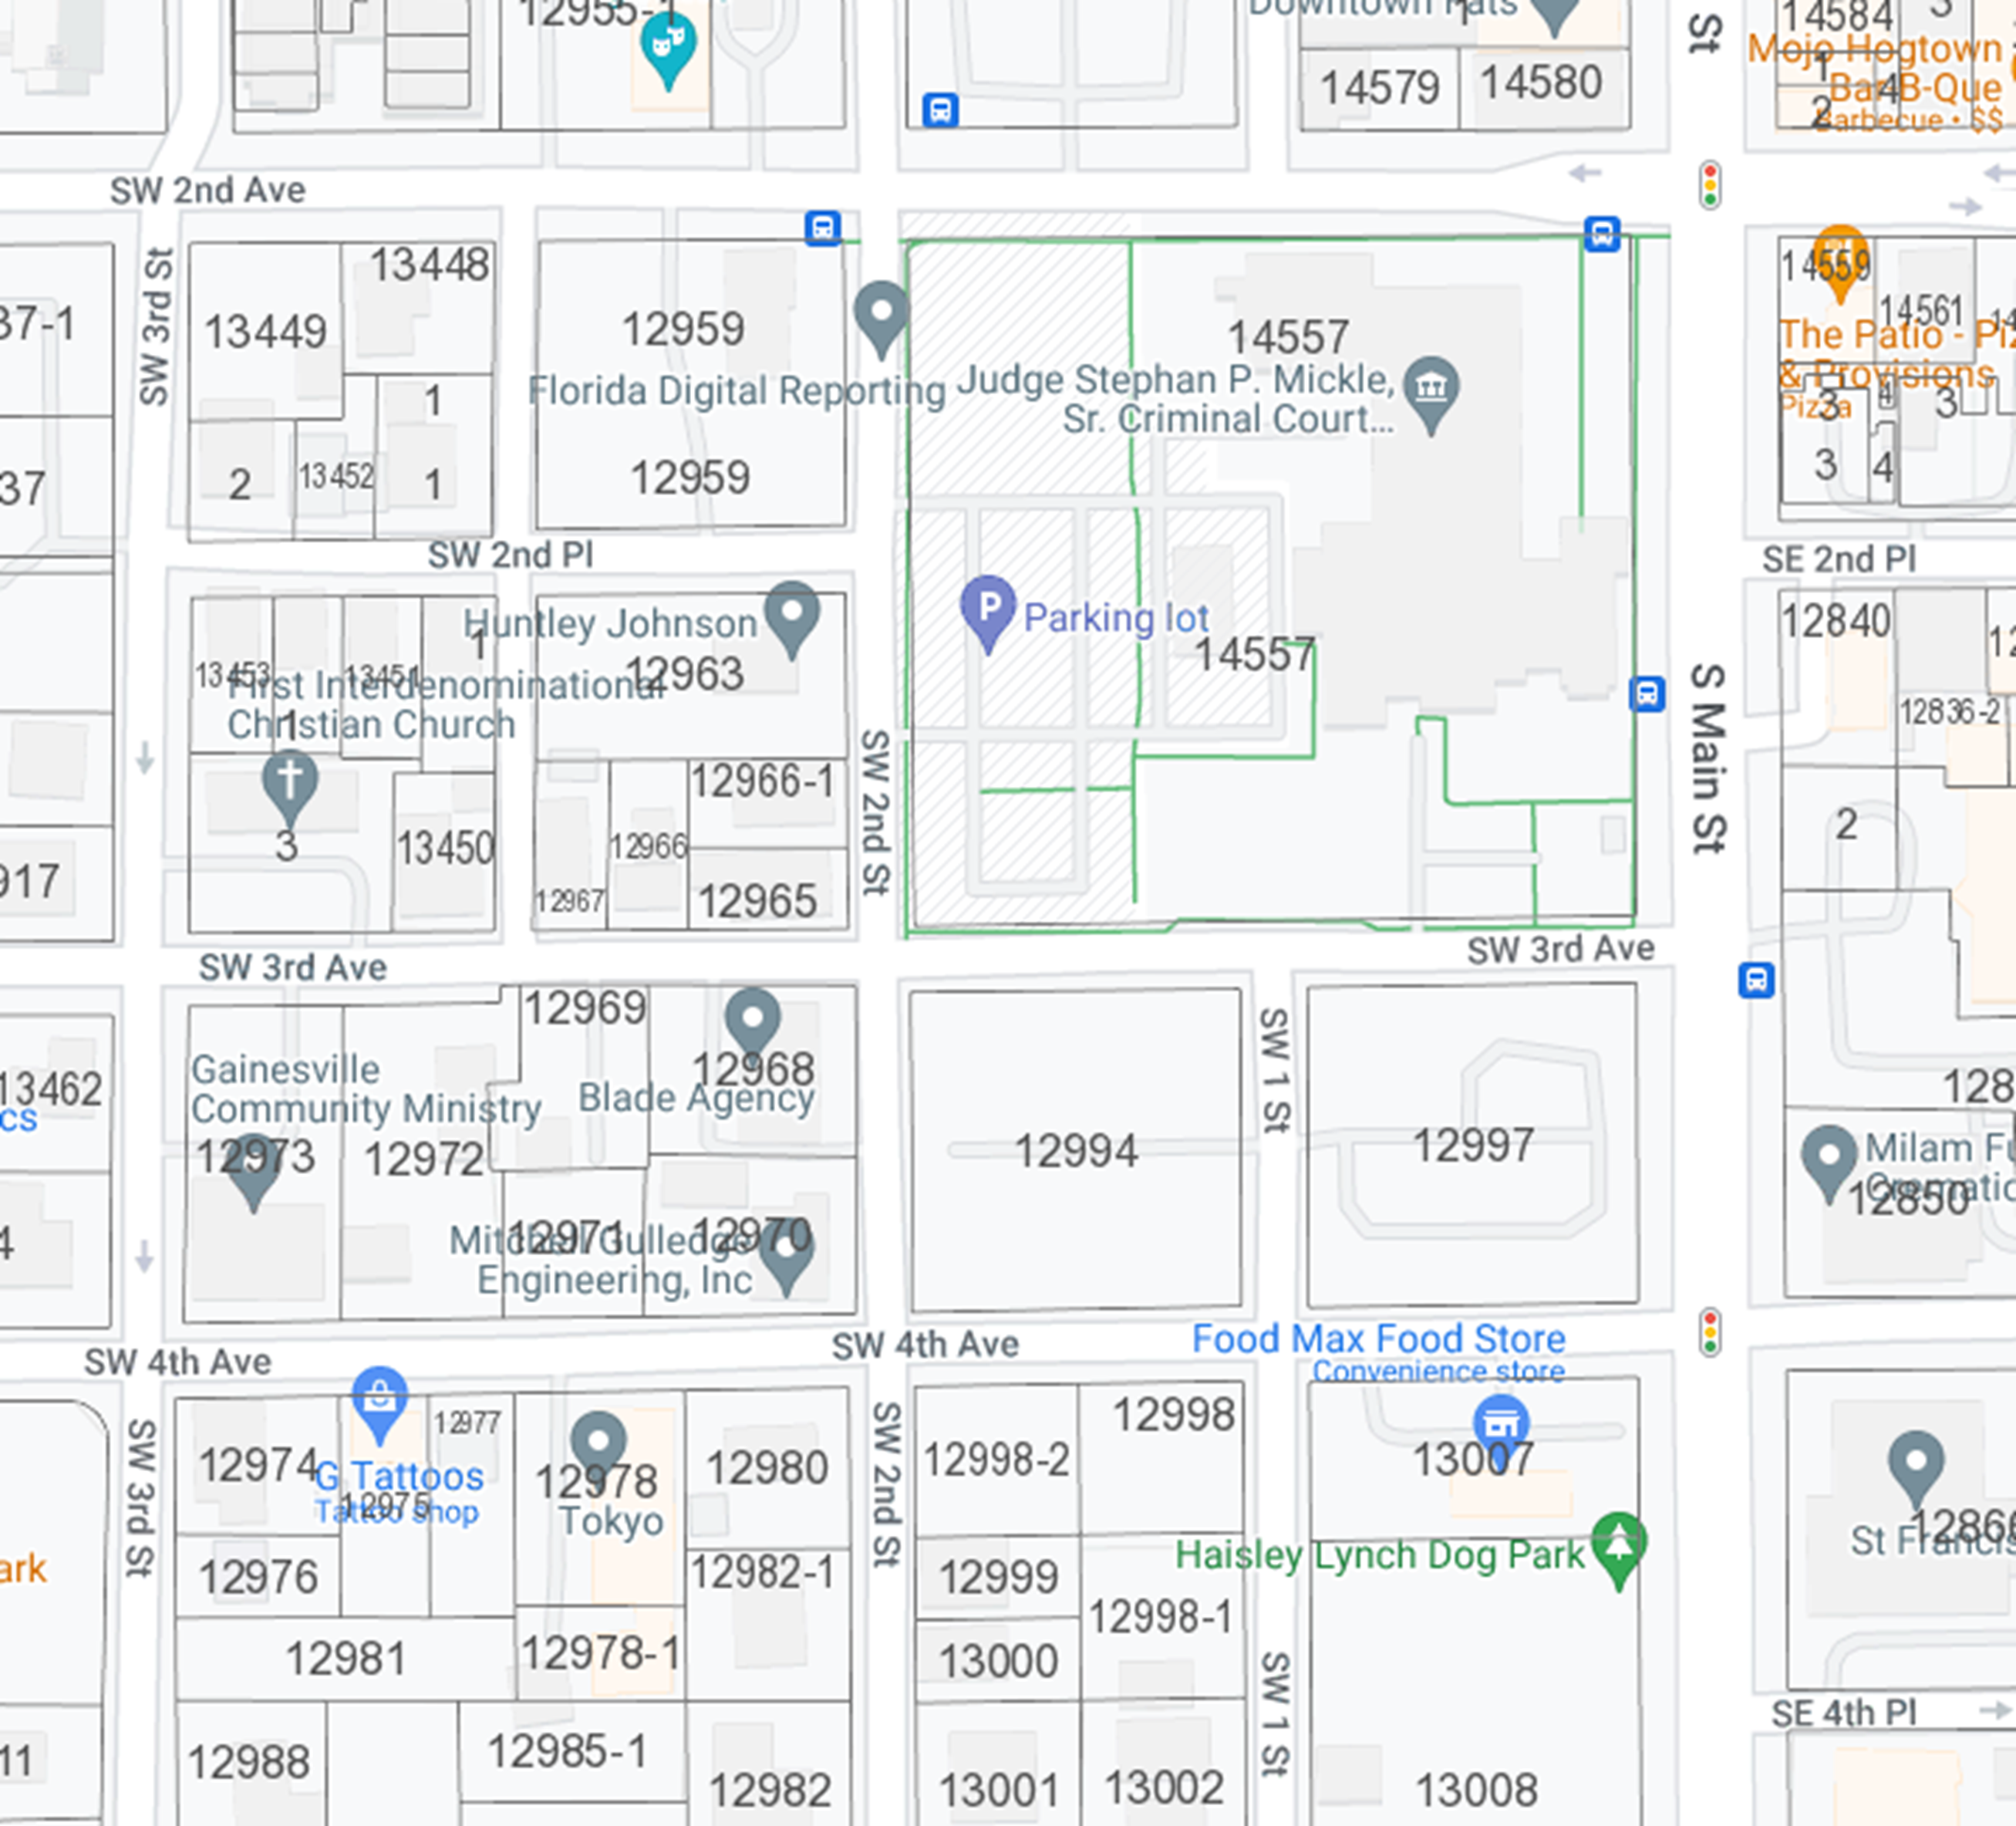
Portion of SW 3rd Ave/SW 1st Street to be Vacated (area shown in red)

Slide 5
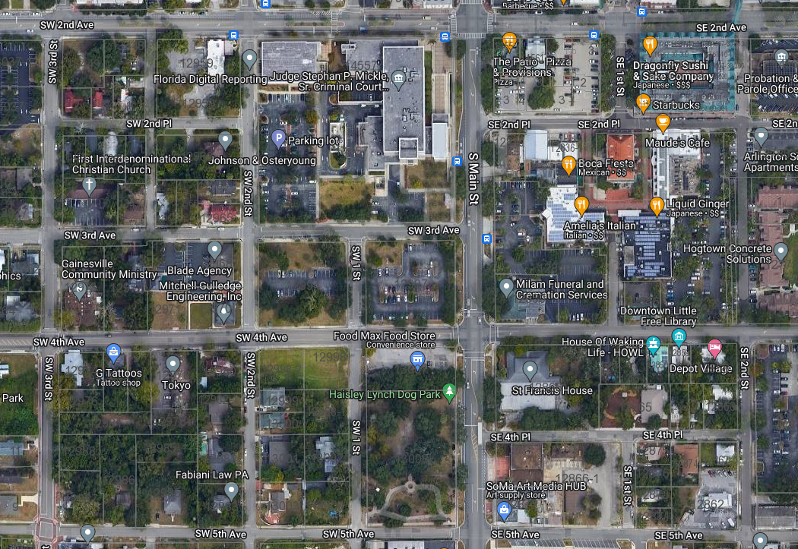
S. Main St.
SW 3rd Ave.
SW 4th Ave.
SW 1st St.

Slide 6
Description & Rationale
Vacate a portion of SW 3rd Ave & SW 1st Street (0.58 +/-acre)
ROW was proposed to be vacated as part of Ordinance 001607 in 2001
Alachua County now has plans to redevelop the area for new buildings on the site
An east-west urban walkway will replace SW 3rd Avenue for connectivity between SW 2nd Street and S. Main Street

Slide 7
Next Steps
eda will submit the application for the ROW vacation to the City of Gainesville
City of Gainesville will review the application
City of Gainesville will notify neighboring property owners of the public hearing before the City Plan Board
Plan Board meeting (Aug or September 2023)
City Commission meeting (Dec 2023 or Jan 2024)

Slide 8
Contact Information
Person: Stephanie Sutton
Phone: (352) 373-3541
Email: ssutton@edafl.com
Web site: www.edafl.com/neighborhoodworkshops
Mail: 720 SW 2nd Avenue
South Tower, Suite 300
Gainesville, FL 32601

Slide 9
Questions

