Slide 1
Site Plan
St. Andrews Church
Parcels 06091-002-001 & 06091-002-002
Neighborhood Workshop: August 16, 2023

Slide 2
Meeting Guidelines
This meeting is informational only
It is required as a part of the City of Gainesville review process
You have been muted upon entering
If you have a question, either:
Unmute yourself to speak
Type your question in the chat box
⬇ UNMUTE/MUTE ⬇ CHAT

Slide 3
Agenda
Introductions
Property Location
Project Description
Existing Zoning & Land Use
Proposed Site Plan
Next Steps
Contact Information
Questions

Slide 4
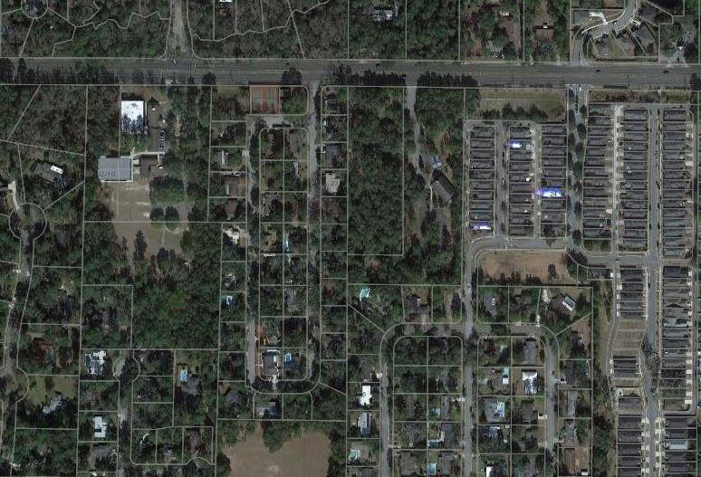
Site Location: 2715 & 2723 NW 39th Avenue
723 NW 39th Avenue
NW 39th Avenue
Subject Property
Church Site
NW 26th Terrace
Subject Property
Subject Property
NW 36th Lane
Gainesville Housing Authority
NW 28th TERR
Gainesville Housing Authority

Slide 5
Project Description
Property Size: 7.39 +/- acres
Current Use: Church & Single-family dwelling
Address: 2715 NW 39th Avenue
Tax Parcels: 06091-002-001 & 06091-002-002
Current zoning (RSF-1) allows Places of Religious Assembly by Special Use Permit (SUP)
There is an approved Special Use Permit for the church on the property with proposed expansion
Site Plan will permit a new sanctuary (approx. 23,000 SF & associated improvements (parking, utilities, and stormwater)

Slide 6
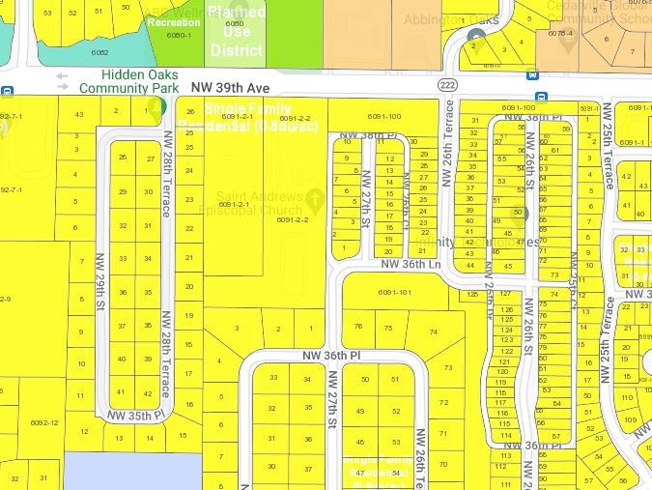
Future Land Use Map
Single
Family

Slide 7
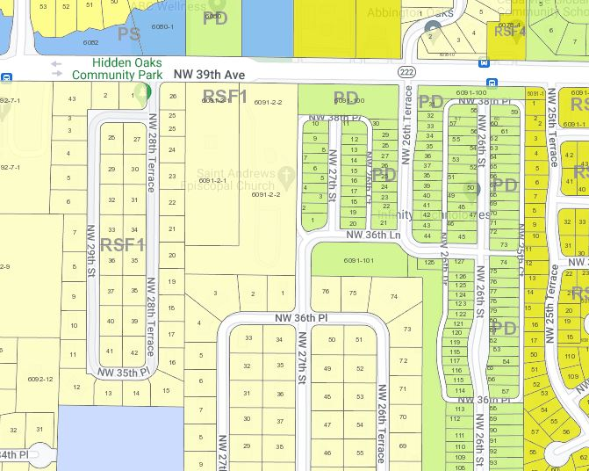
Zoning Map

Slide 8
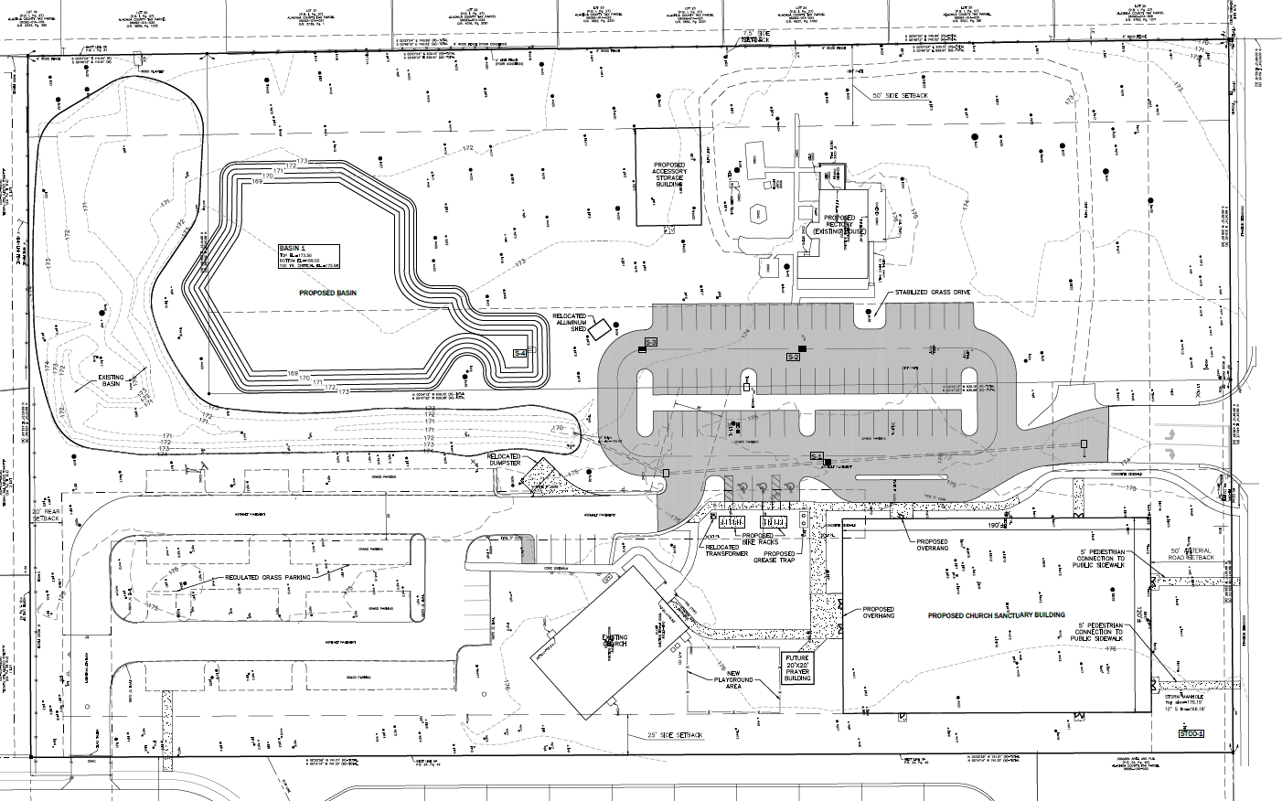
Proposed Site Plan
Existing Basin
Proposed Storage
Rectory/
Existing Home
Rectory/
Existing Home
Proposed Stormwater Facilities
Proposed
Parking Area
NW 39th Avenue
U8
Existing Parking Area
Proposed Sanctuary Building
Existing Church

Slide 9
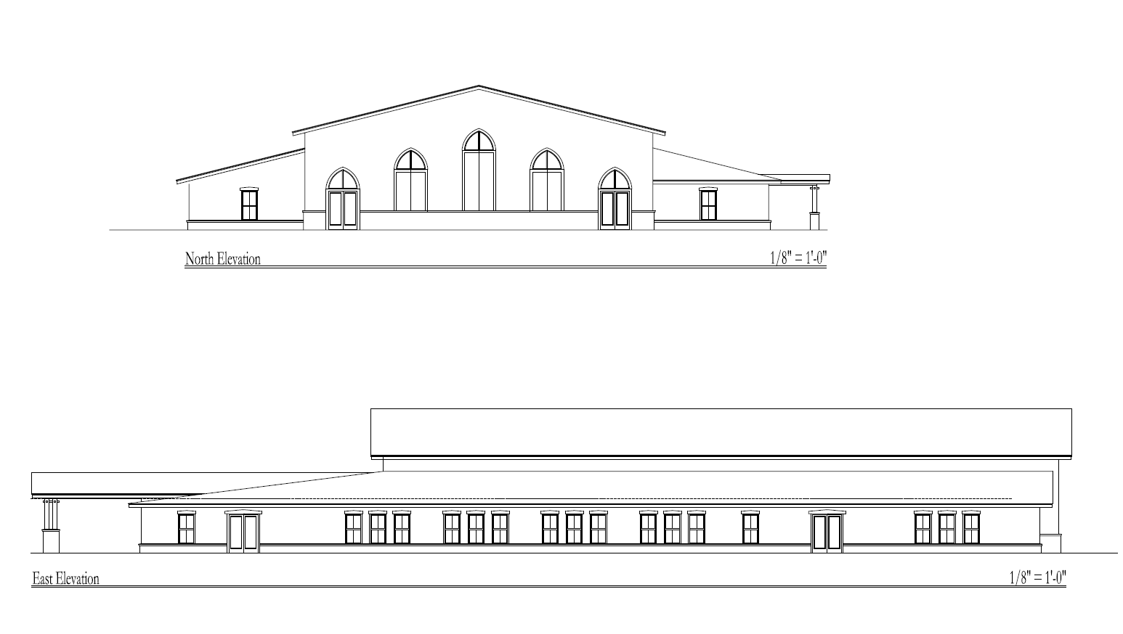
Conceptual Elevations
U8

Slide 10
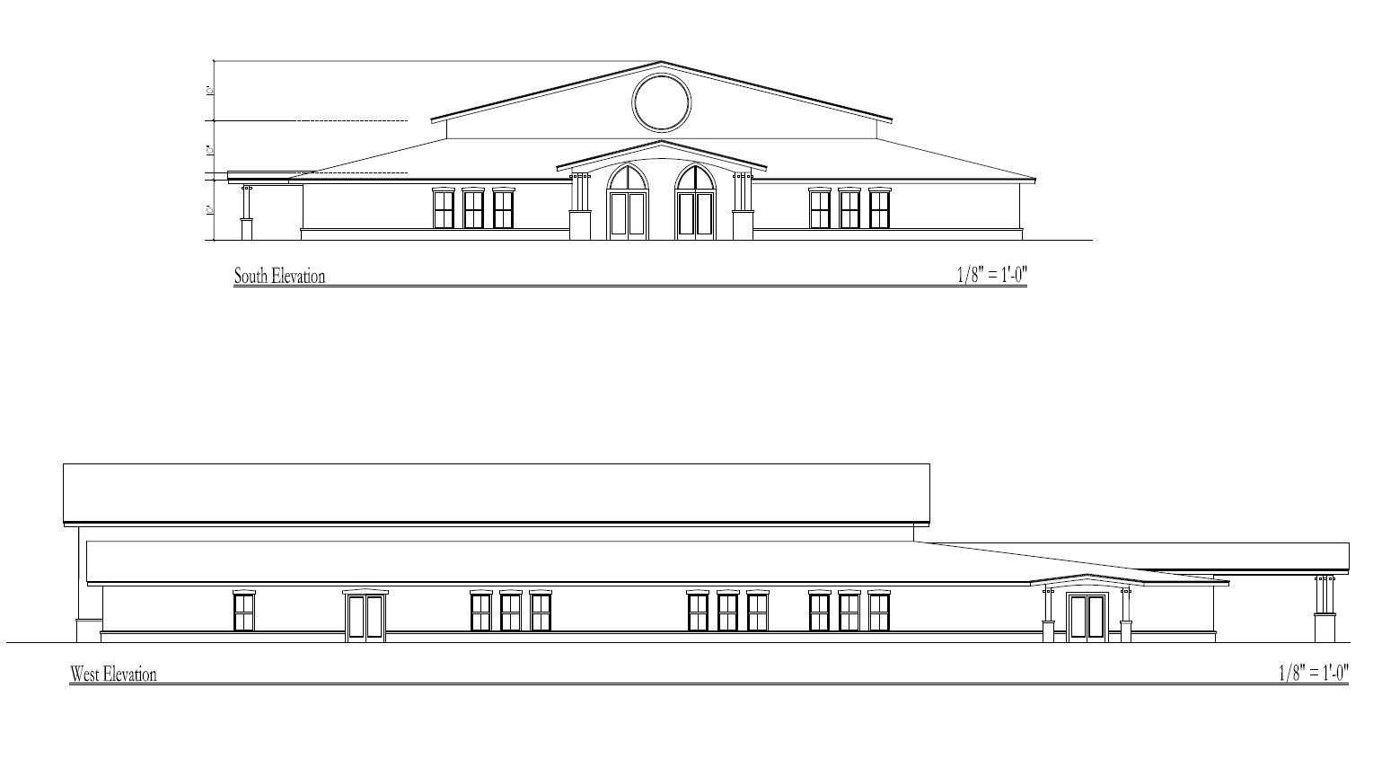
Conceptual Elevations
U8

Slide 11
Next Steps
eda will submit the application for the Site Plan to the City of Gainesville / GRU (tentatively scheduled for September)
City of Gainesville will review the application (expected September – January)

Slide 12
Contact Information
Person: Sergio Reyes
Phone: (352) 373-3541
Email: sreyes@edafl.com
Website:
www.edafl.com/neighborhoodworkshops
Mail: 720 SW 2nd Avenue
South Tower, Suite 300
Gainesville, FL 32601

Slide 13
Questions

