Slide 1
Blues Creek
Design Plat
Neighborhood Workshop September 13, 2023

Slide 2
Agenda
Property Location
Land Use & Zoning
Project Description
Next Steps
Contact Information
Questions

Slide 3
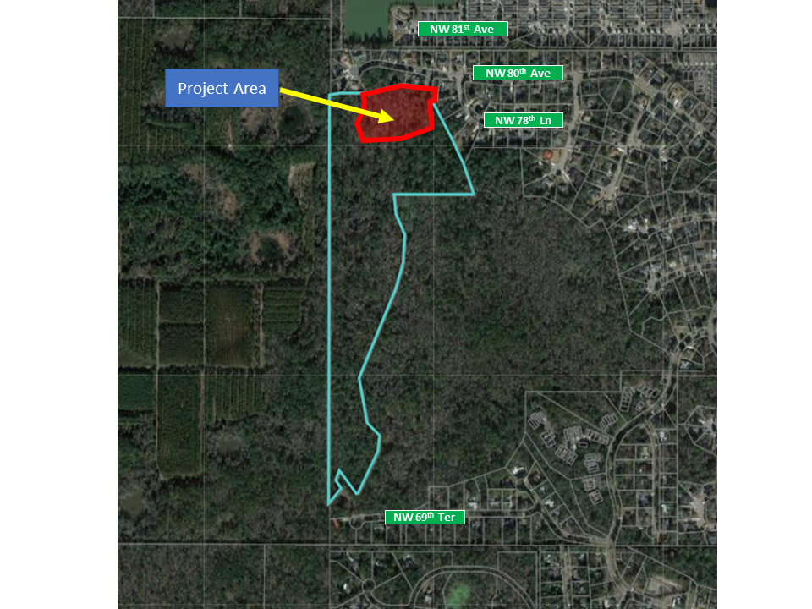
Project Area (Approx. 4.2 Ac.)
Property Location Map
Conservation Land Use & Zoning Area (Approx. 32.5 Ac.)

Slide 4
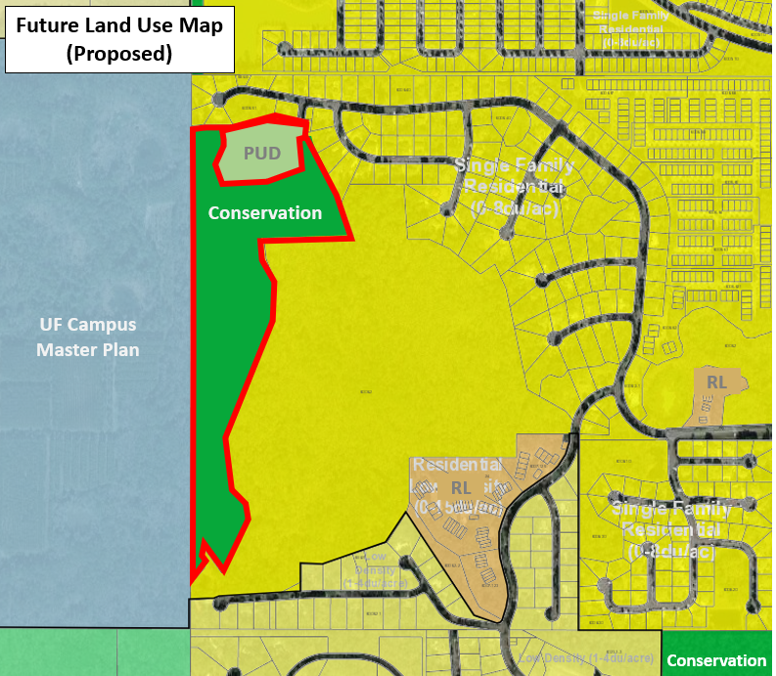
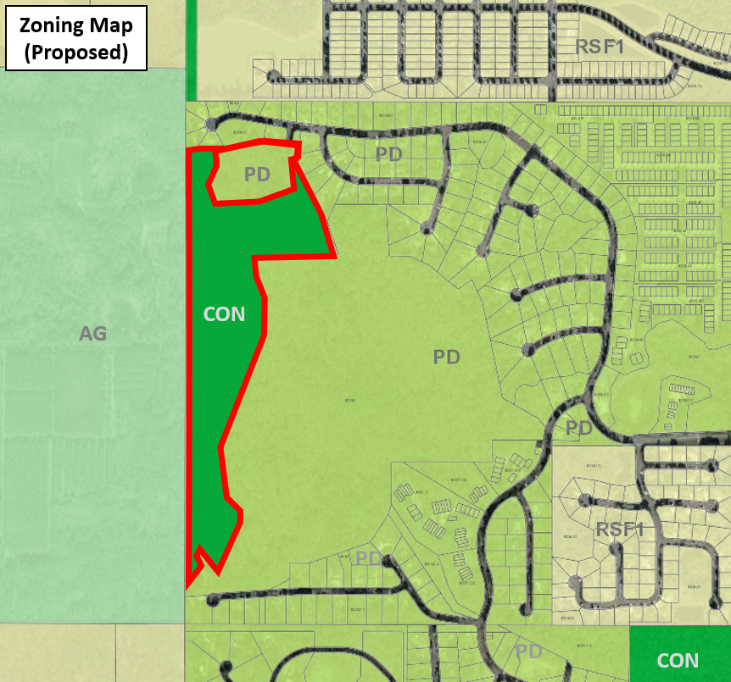
Existing Land Use & Zoning Maps

Slide 5
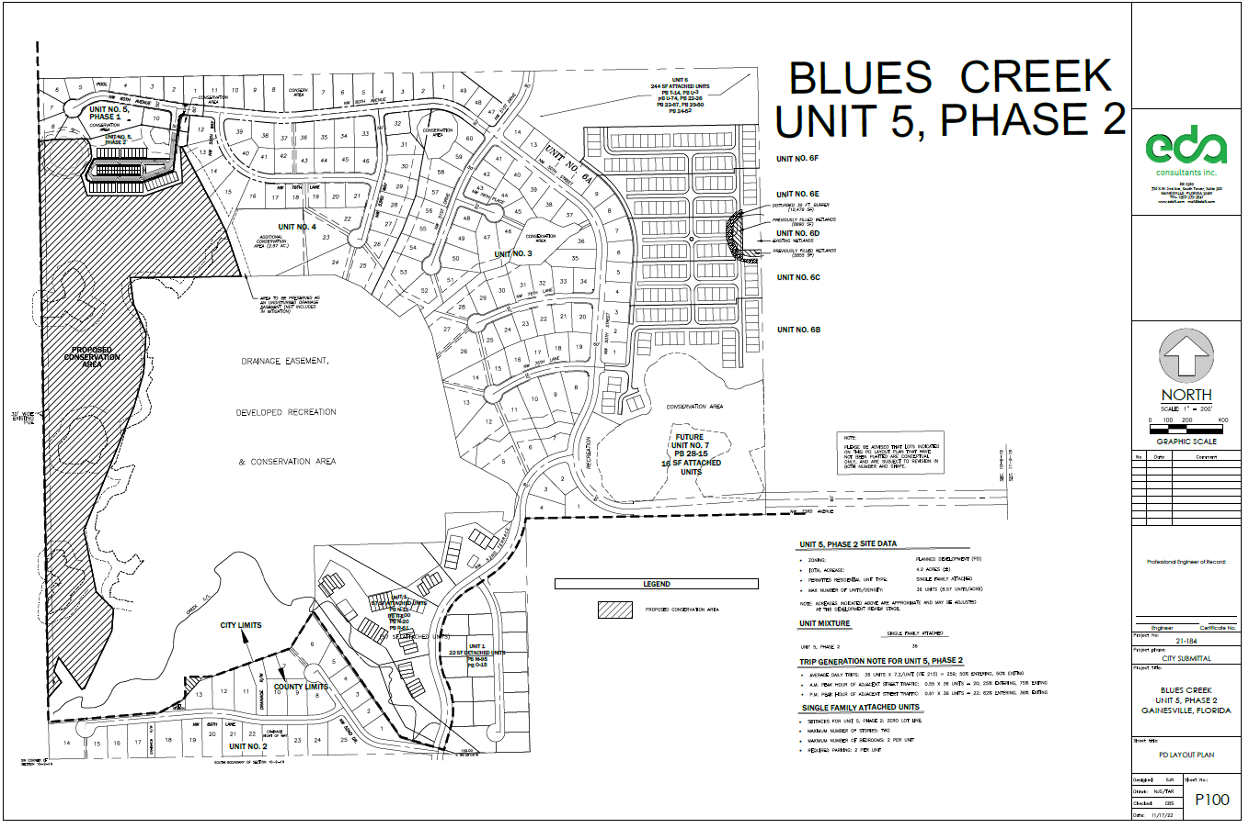
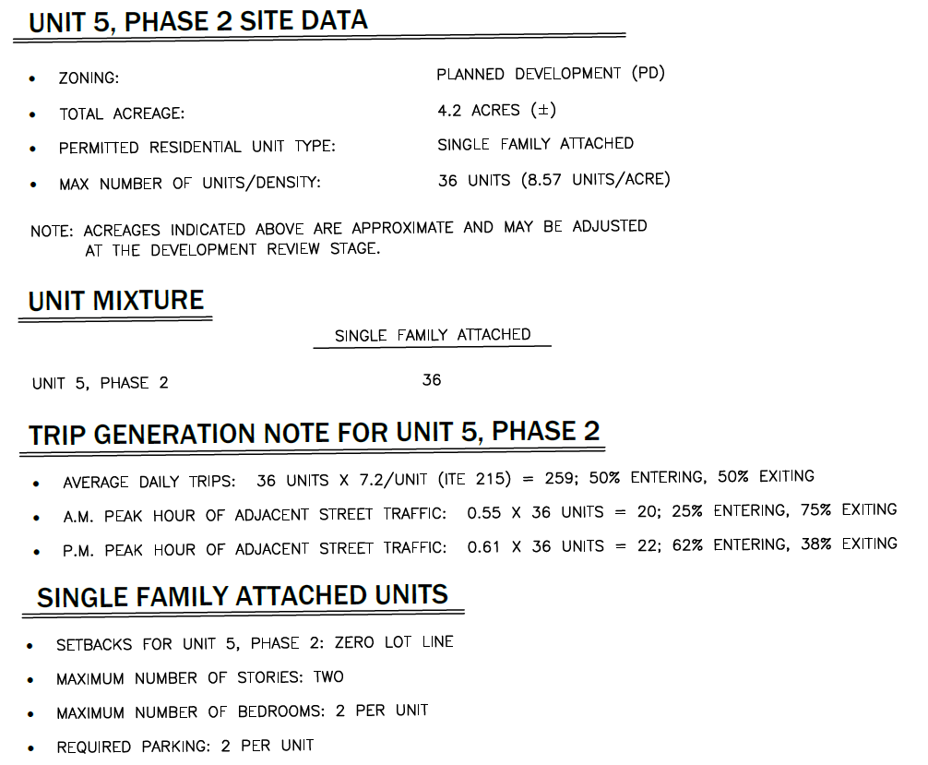
PD Zoning Area
Approved PD Layout Plan
Conservation Zoning Area
Units will be platted & sold (Single Family Attached)

Slide 6
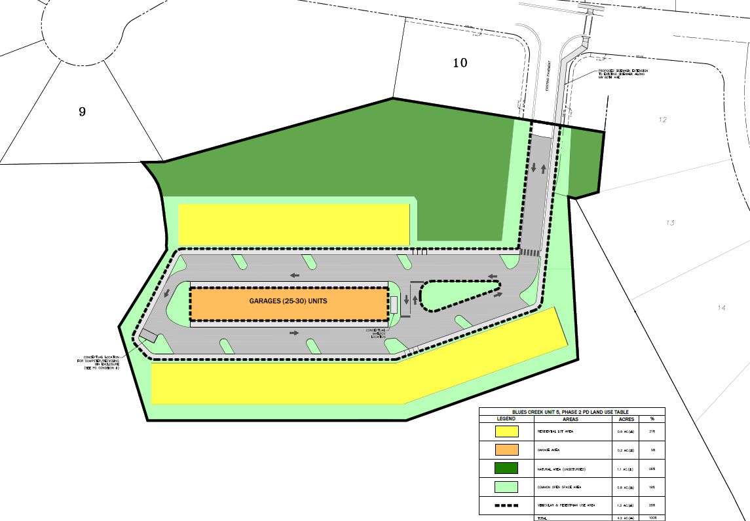
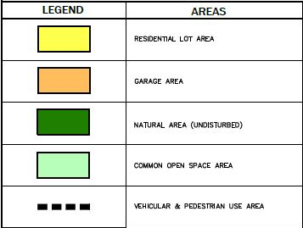
Approved PD Layout Plan
Natural Area
Residential Lot Area
Proposed PD Zoning Area
Residential Lot Area
Proposed Conservation Zoning

Slide 7
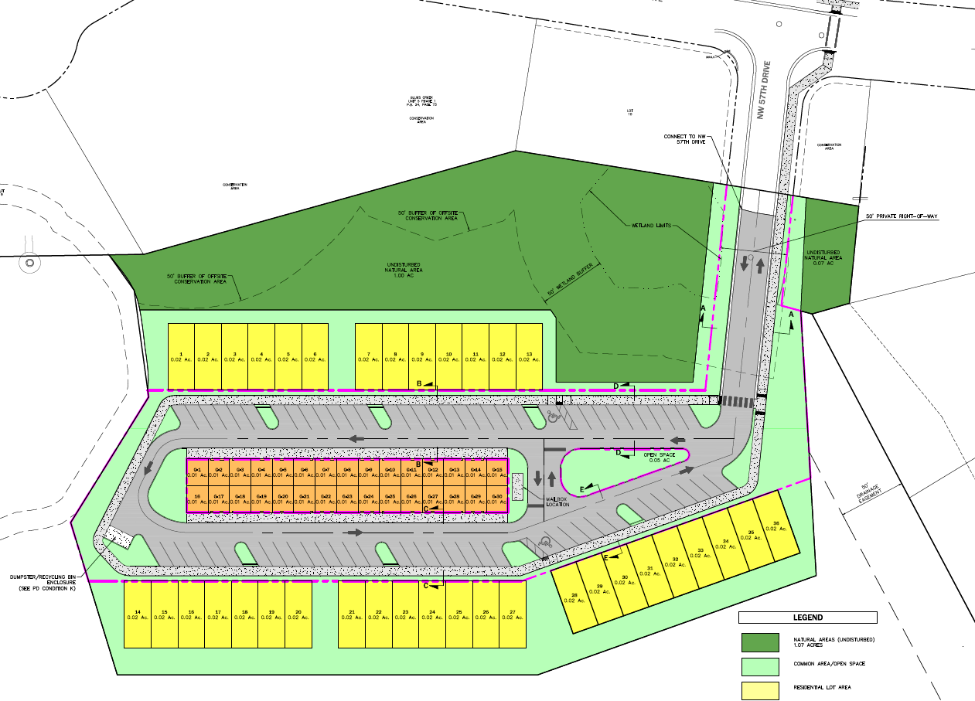
Proposed Design Plat

Slide 8
PD & Design Plat Conditions / Standards
Proposed Use: single-family attached units on platted lots with accessory garages
36 residential units / platted lots
72 bedrooms (Max.)
2 story buildings(Max.)
Interconnected sidewalk network
Natural Areas & Landscape Buffers
Connection to GRU Utilities
Stormwater / Drainage System
Exterior lighting standards

Slide 9
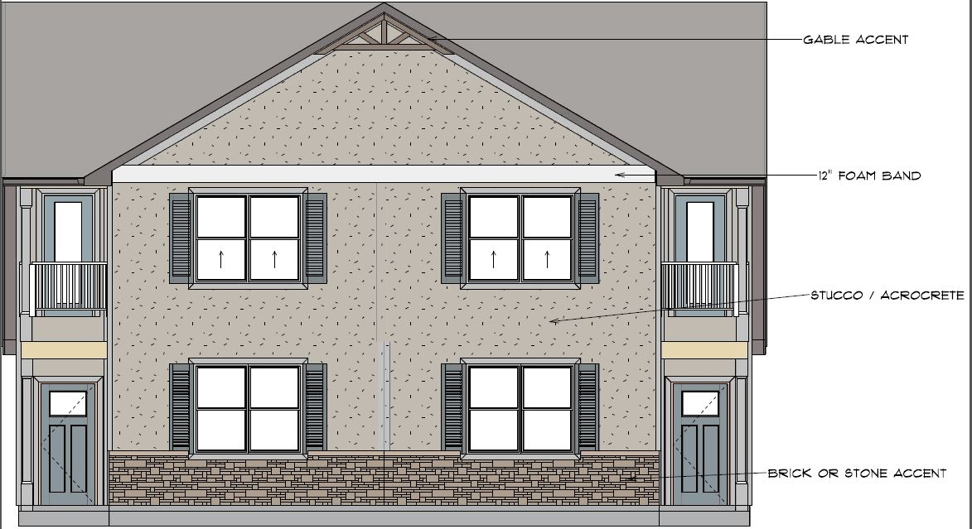
Conceptual Elevations

Slide 10
City Subdivision Approval Process
Four Primary Applications:
1. Land Use & Zoning Map Changes (Approved)
2. Design Plat (Current Proposed Application)
3. Construction Plans (Next Step)
4. Final Plat (Final Step)

Slide 11
Next Steps
EDA will submit the application for Design Plat to the City of Gainesville
City of Gainesville will review the application
City of Gainesville will notify neighboring property owners of the public hearing before the City Development Review Board (DRB)
DRB meeting date (TBD by City)
City Commission meeting (TBD by City)

Slide 12
Contact Information
Phone: (352) 373-3541
Email: permitting@edafl.com
Website: www.edafl.com/neighborhoodworkshops
Mail: 720 SW 2nd Avenue
South Tower, Suite 300
Gainesville, FL 32601

