Slide 1
Dance Alive
Site Plan
Neighborhood Workshop September 5, 2023

Slide 2
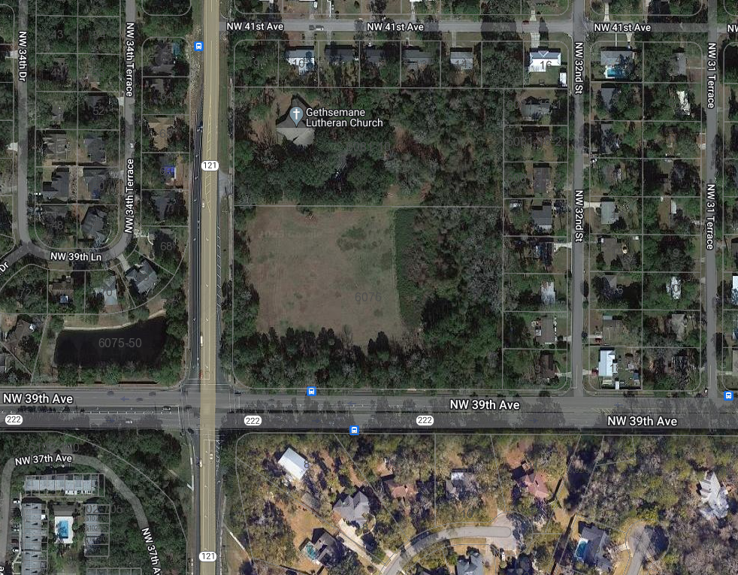
Property Location Map
NW 34th St.
Subject Property
5.7 Ac. (+/-)
NW 39th Ave.

Slide 3
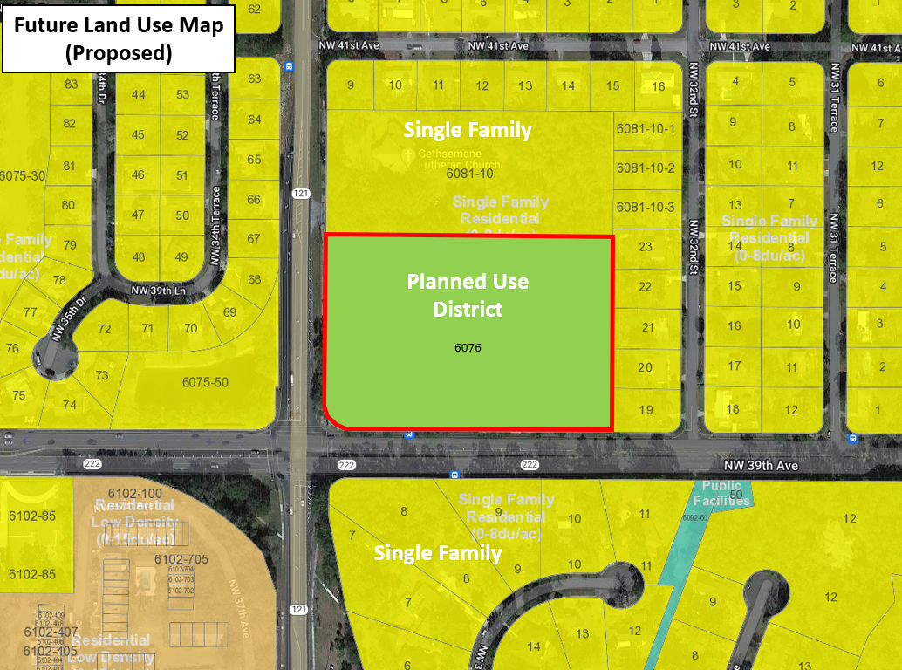
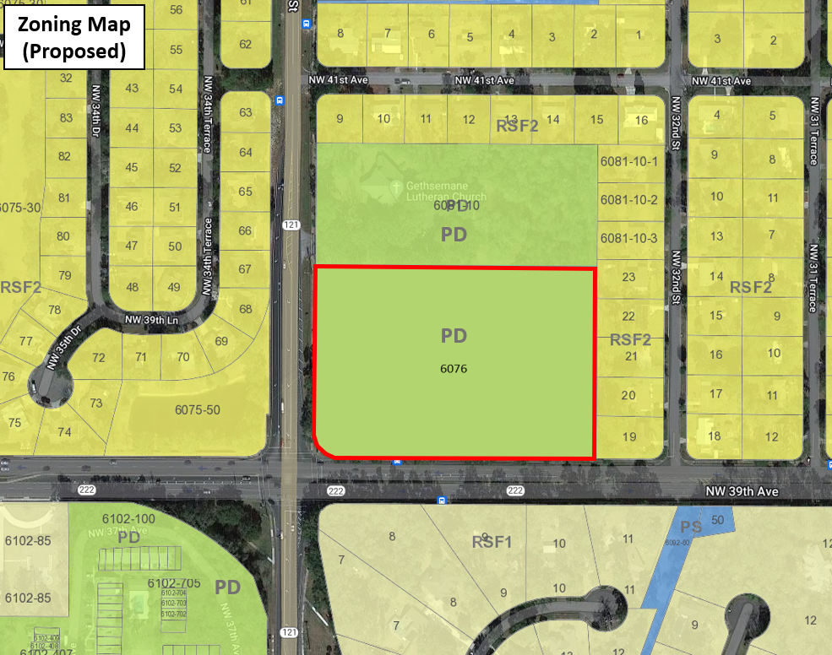
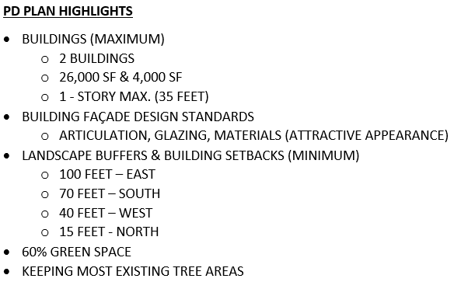
Future Land Use & Zoning
NW 34th St.
NW 34th St.
NW 39th Ave.
NW 39th Ave.
Permitted Uses in PD / PUD
Dance studio including classes and rehearsals
Yoga and Pilates classes
Music classes
Theater for accessory dance and music performances
Customary accessory uses
Theater rental for non-profit cultural organization performances
Accessory outdoor events
Storage building

Slide 4
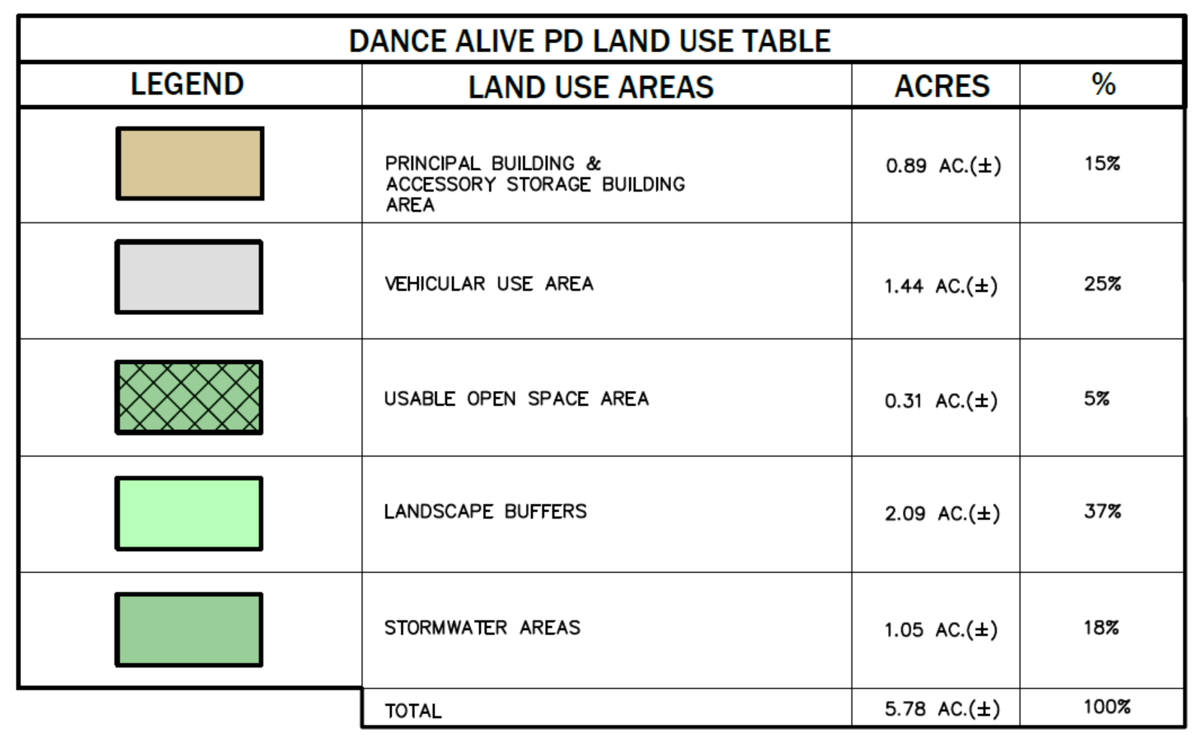
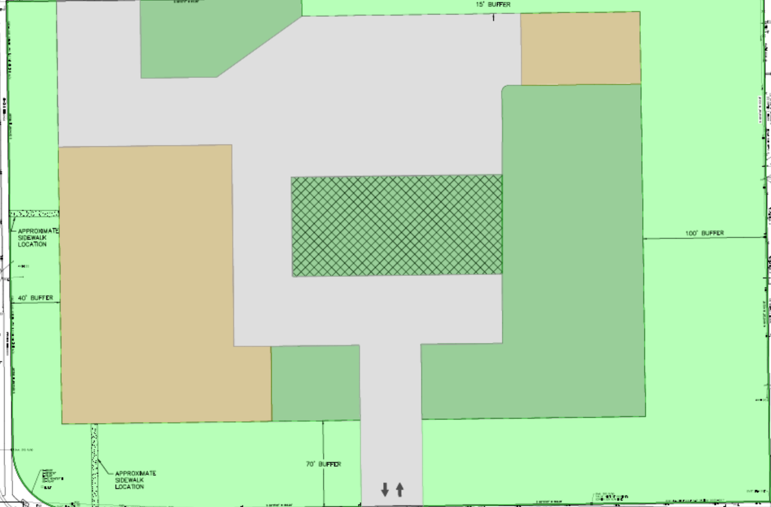
Approved PD Plan
&
Aerial Photo
SMF
BLDG.
DRIVEWAY / PARKING
OPEN SPACE
BUFFER
BUILDING
SMF
BUFFER
BUFFER
NW 39th Ave.
NW 34th St.

Slide 5
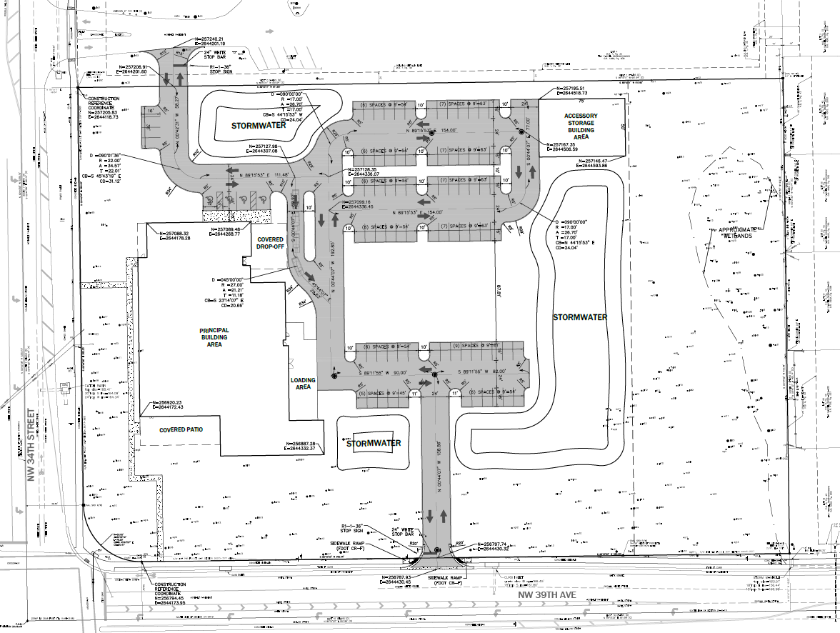
Proposed Site Plan

Slide 6
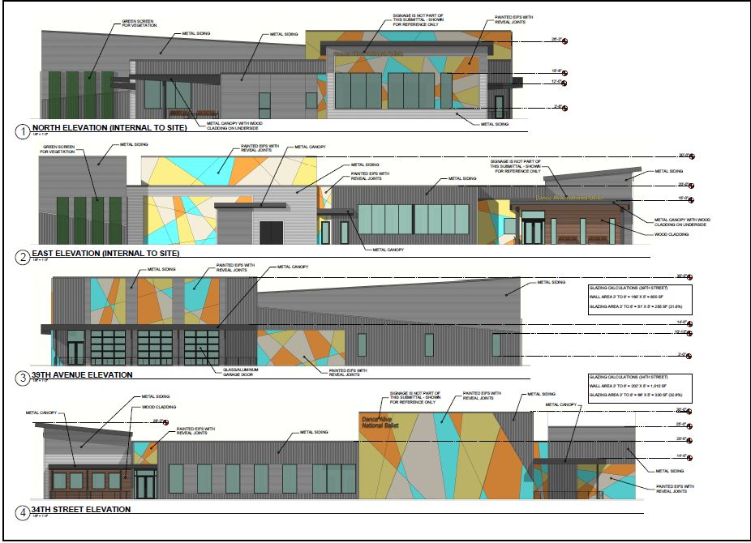
Conceptual Building Elevations

Slide 7
Next Steps
EDA will submit the Site Plan application to the City of Gainesville
City of Gainesville will review the applications
Applicant will address any City review comments
Development Review Board meeting (TBD: Approx. 3 Months)

Slide 8
Traffic
Project will have higher percentage of non-peak hour traffic
Meeting held with FDOT
Input received regarding proposed access locations:
39th Ave. (right-in, right-out / aligned with hard median)
34th Street (shared driveway with Church (no new driveways / as far from intersection as possible.
Reviewed project with City of Gainesville
FDOT completed / planned safety improvements:
Converted EB / WB Protected/Permissive LT to Protected Only LT for 24/7 (Completed May, 2023)
Extended NB/SB RT Lanes with previous safety project along S.R. 121 (Completed)
Planned to add SB RT “Turning Vehicle Stop for Ped” signs and “No Ped” signs with “Use Crosswalk” Plaques on the Median at East Leg
Considering to add EB RT Lane

Slide 9
Contact Information
Phone: (352) 373-3541
Email: permitting@edafl.com
Web site: www.edafl.com/neighborhoodworkshops
Mail: 720 SW 2nd Avenue
South Tower, Suite 300
Gainesville, FL 32601

Slide 12
Trip Generation Comparison
ITE Code | Use | ADT | PM Peak | AM Peak
495 | Dance Studio & theater | 455 | 40 | 30
150 | Storage | 11 | 1 | 1
150 | Accessory Storage | 7 | 1 | 1
TOTAL: |  | 473 | 42 | 32
210 | Single-family
TOTAL: |  | 434 | 43 | 32
 | Net Change: | +39 | -1 | 0

