Slide 1

Gerber Collision –
Site Plan and Replat
Gerber Collision –
Site Plan and Replat
Neighborhood Workshop
October 12, 2026

Slide 2
Meeting Guidelines
This meeting is informational only
It is required as a part of the City of Gainesville review process
You have been muted upon entering
If you have a question, either:
  Unmute yourself to speak
  Type your question in the chat box
⬇ UNMUTE/MUTE ⬇ CHAT

Slide 3

Property Summary
Tax Parcel Number: 07240-045-000
Location: 4600 block of SW 40th Boulevard
Future Land Use Map Designation: Industrial and Conservation
Zoning District: Business Industrial and Conservation
Two proposed applications:
  A Development Plan application for an approx. 16,600 SF automotive repair facility with associated infrastructure improvements.
  A Replat/Final Plat to redefine lot boundaries and create a lot for the development area.

Slide 4
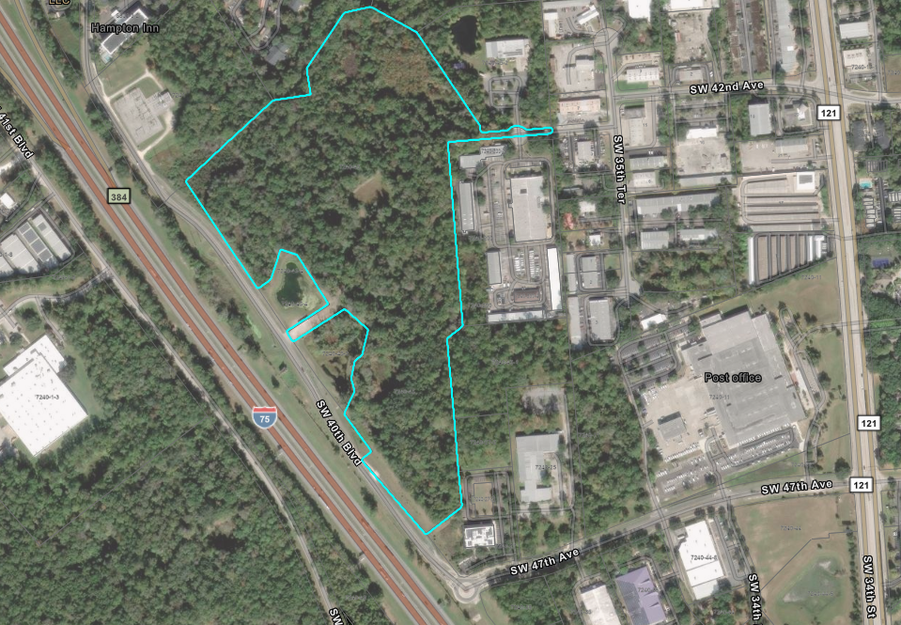
Location Map
Location Map
Interstate 75
SW 40th Blvd
SW 47th Ave

Slide 5
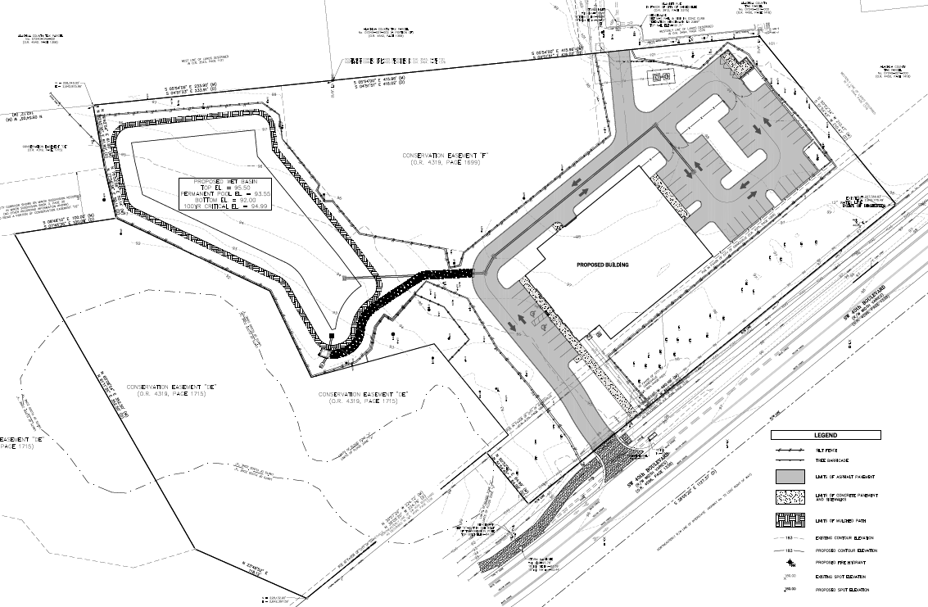
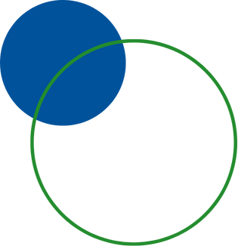
Conceptual Site Plan
Conceptual Site Plan
Stormwater
Building Area

Slide 6
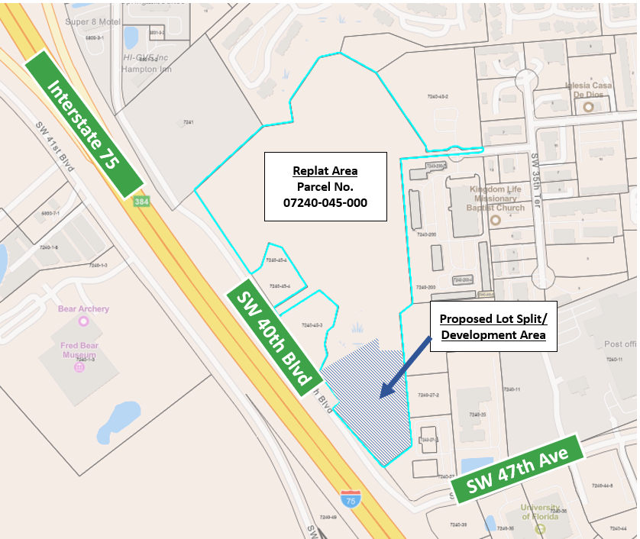
Proposed Replat/Final Plat
Proposed Replat/Final Plat

Slide 7
Next Steps
Next Steps
Neighborhood Workshop – October 12, 2026
Development Plan
  City Submittal – October 2026
Replat/Final Plat
  City Submittal – November 2026
Presentation will be posted to: http://edafl.com/neighborhoodworkshops
Follow-up questions? Email permitting@edafl.com or call 352-373-3541

Slide 8
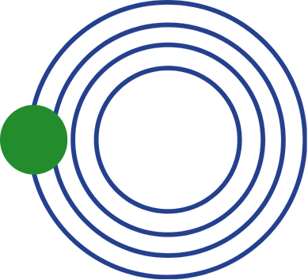
Questions
Questions

